Slide 1
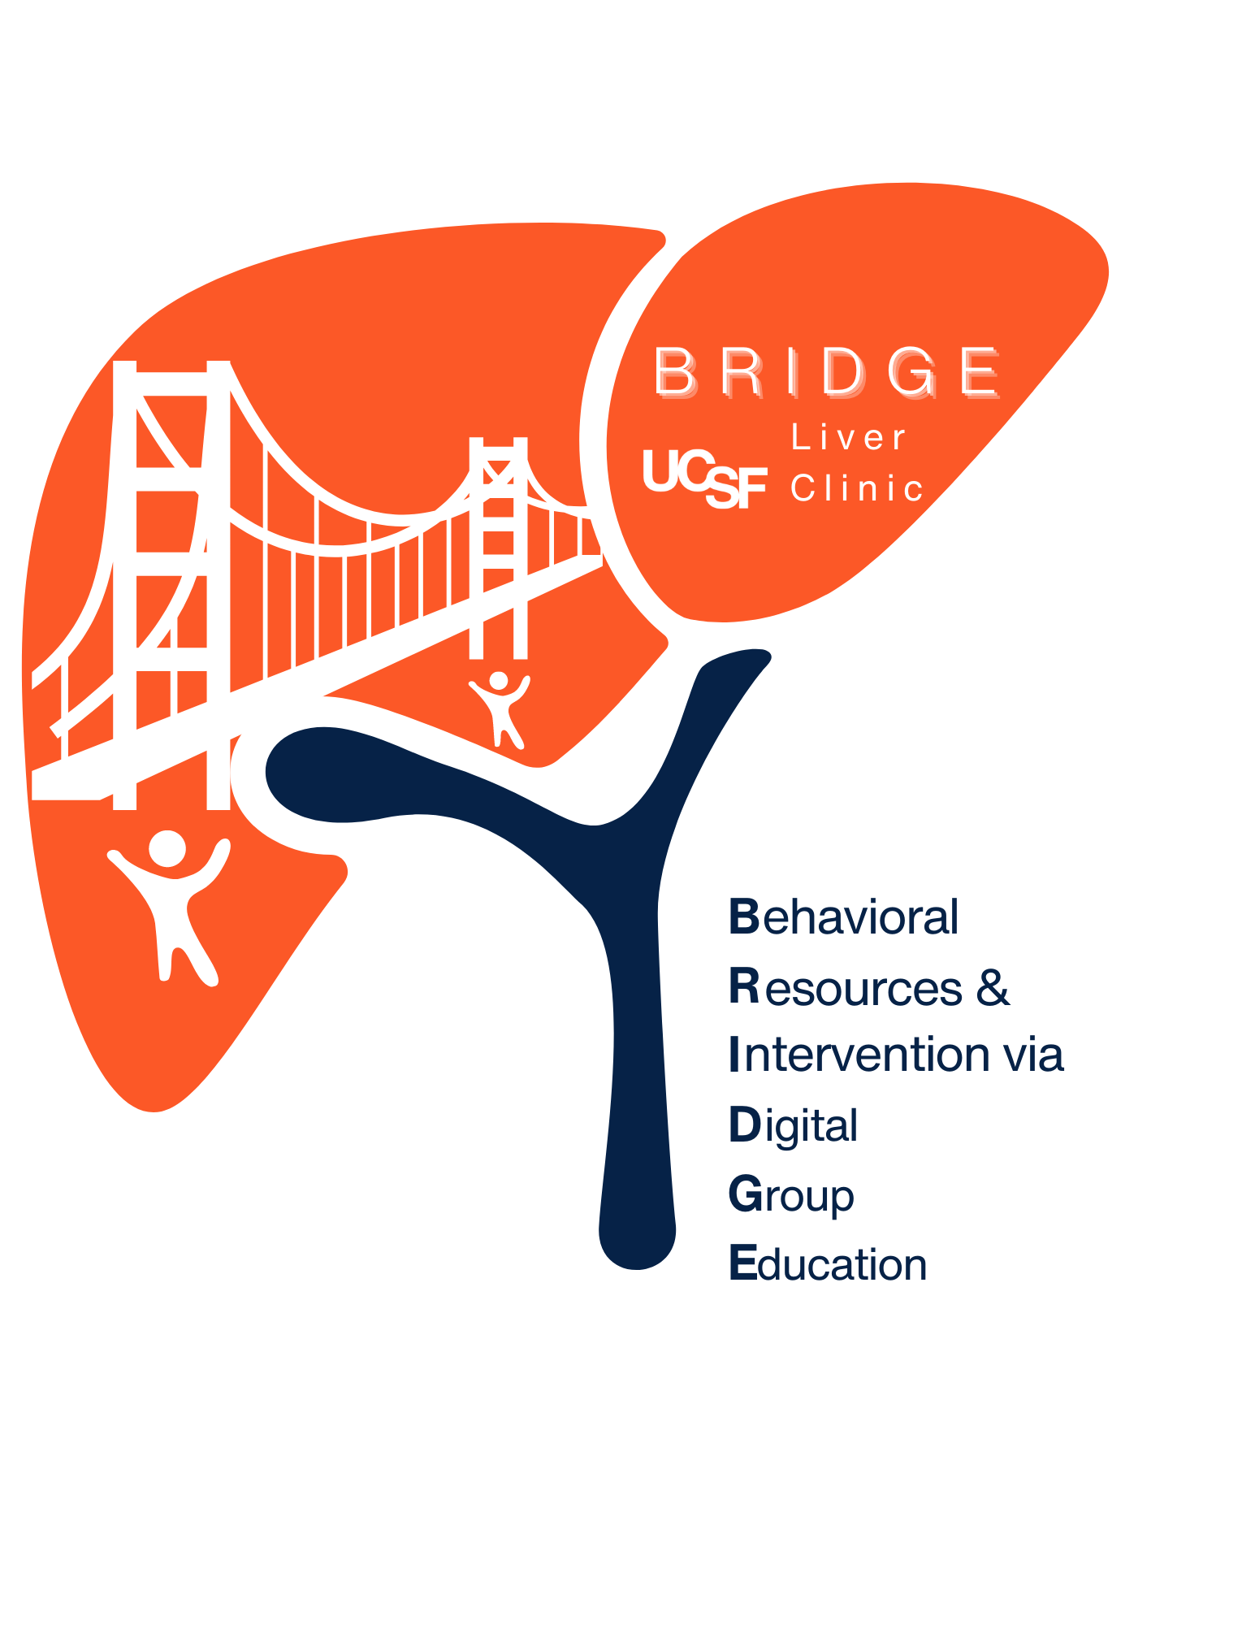
BRIDGE Session #6
Stress Management and
Protecting Sleep
Notes:
Thank you so much for your participation in the course. This will be our last session. My hope is that we have provided you all with useful education, information and new ways of thinking about how you can make changes in some habits for liver health.

Slide 2
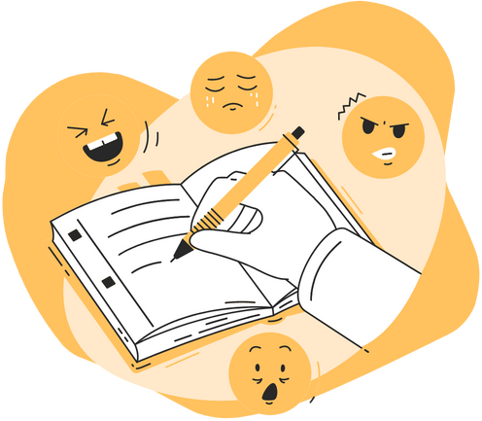
Reflection
Brief reflections from last session:
  What went well since last session?
  Were there challenges and were these expected?
What changes in the patterns in your behaviors have you noticed when you are under stress, if any?
Notes:
What went well?
What changes in patterns of behavior do you notice when you are under stress?

Slide 3
Outline of today’s session
Describe chronic stress and its impact on health
Build strategies to manage stress reactions
  Noticing the connection between thoughts and emotions
  Relaxation and protecting sleep
  Buffering the effects of stress through our social support network
Notes:
We will start describing what happens to our body when we are under stress and the impact of chronic stress on our physical health.
We hope help you build strategies to manage stress reactions by noticing emotions and self-talk, protecting sleep and building a social support network.

Slide 4

How your body responds to stress
Relaxation Response:
Rest & Digest
Stress Response:
Fight or Flight
Parasympathetic Nervous System
Sympathetic Nervous System
Parasympathetic system ”cools down”
Slide courtesy of Jamie Cohen PsyD.
Notes:
How do our bodies respond to stress? Our bodies were built for stress.
The sympathetic nervous system activates internal resources to protect us. The fight or flight response makes the body stronger and faster when danger is present, increasing blood pressure, heart rate and breathing rate. It increases hormones and chemicals in our brains to give us energy, and focus our attention when it is needed
The parasympathetic nervous system acts to return the body back to balance after the fight or flight response.
The balance is like a thermostat: while the sympathetic system heats things up, the parasympathetic system cools it down
However, when we don’t have the resources to keep this in balance over time, we overheat and the stress response becomes chronic.

Slide 5
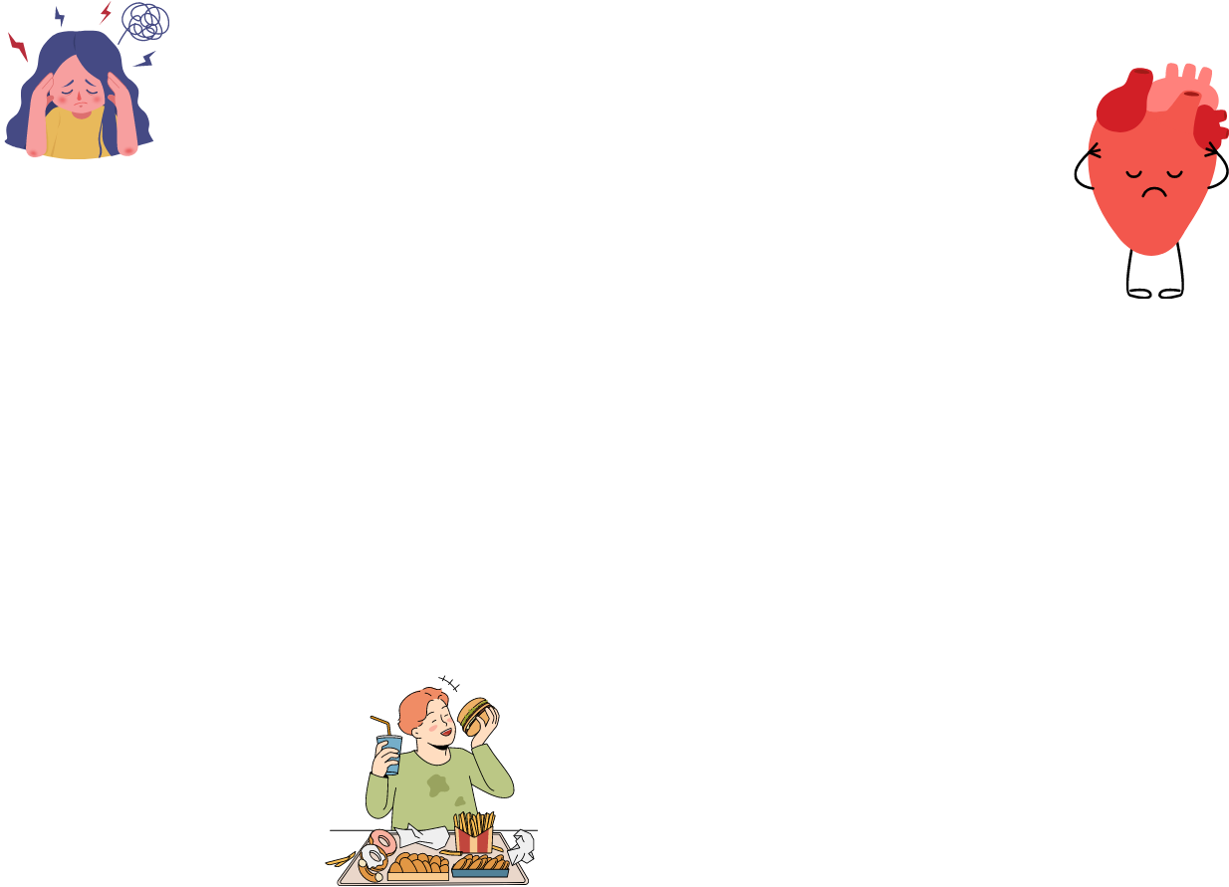
Downstream effects of chronic stress
Pre-existing physiological or psychological vulnerability
Physiological and psychological wear and tear
fatigue, difficulty concentrating, anxiety, depression, apathy
ILLNESS:
Obesity, increased viral illnesses, high blood pressure
Exposure to chronic stress
Illness precursors and symptoms
Behaviors to cope with stress
Automatic habits
Notes:
There are downstream effects of chronic stress.
When we are exposed to ongoing, chronic stress, it can lead to physical and psychological wear and tear like fatigue, like trouble sleeping, difficulty concentrating as well as coping behaviors which can also can worsen the situation, such as substance use, eating unhealthy foods, not sleeping well, or socially isolating for example. Over time this can lead to symptoms and downstream illness.

Slide 6

“You can’t stop the waves, but you can learn to surf.”
–Jon Kabat Zinn
Notes:
We can’t eliminate all sources of stress from our lives, as it’s an inevitable part of life…but we can learn to manage and respond to it better. .
The goal is to learn how to manage our response to stressors

Slide 7
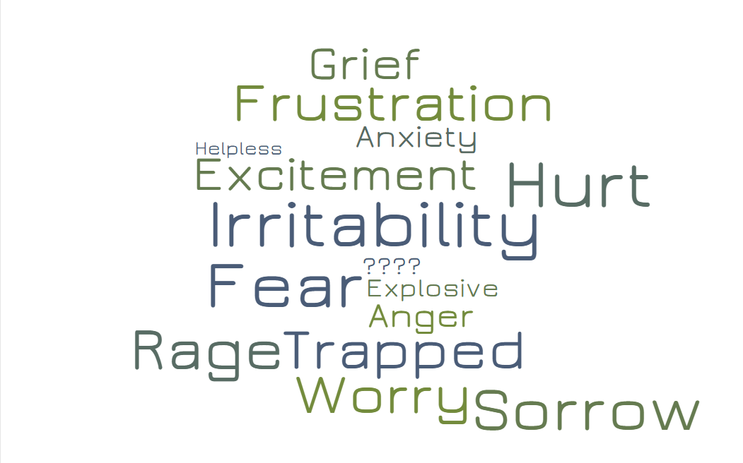

Stress describes many emotions
…it helps to be SPECIFIC with stress
Notes:
Stress is a very general word that can describe many different emotions, like an emotional stress soup.
It helps to be specific about what emotions we’re feeling when we’re distressed, because when we identify them, it can help us to understand ourselves better, which can then help us handle the stress better.

Slide 8
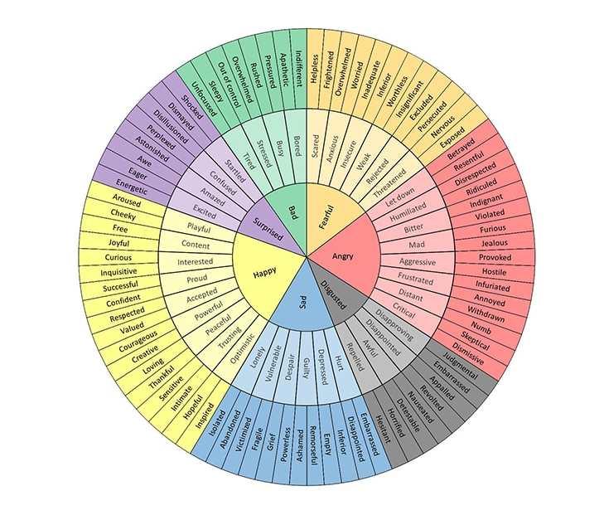
Noticing Emotions and Journaling
Emotions Wheel handout is a tool to help us to find the words to describe our feelings
Notes:
The emotions wheel handout is a tool that can be used to help find the words to describe how we’re feeling.
Noticing our emotions and writing them down can calm our brains down to take care of our emotions before they can lead to an automatic viscious cycle.
******************
Sometimes we run away from our emotions, and sometimes we struggle to identify how we are feeling because we have learned to suppress our emotions, or we have not learned how to identify them.

Slide 9
Strategies for Managing Stress
PAUSE
Slow down, take a breath
NOTICE
Thoughts “what am I thinking or saying to myself”?
Notice the connection between thoughts, feelings and physical reactions
CHOOSE
Thoughts you hold on to and ones you let go of
Emotions, feelings
mood
Thoughts and beliefs
Physical reactions
Notes:
You may recognize these other tools that were introduced in prior sessions: Pause/Notice/Choose is a great tool to use any time of the day to slow ourselves down, taking a breath and noticing the flow of our thoughts, feelings, sensations and what we are saying to ourselves.
We can choose which thoughts to hold on to and which we can let go of.
**********************************************************************************************************************
We can try an exercise on being in the present moment: An example can be with an orange (what you might ask?) but imaging yourself at your kitchen sink peeling an orange. As you peel it you might find your mind drifting back to something that happened last week or something you have to do tomorrow. But if you are in the moment you can really notice the sweet smell of the orange as you peel the skin away, may feel some of the spray of juice that splashes up, feel the juice running over your hands and taste the sweet/citrus tang as it touches your tongue.

Slide 10
Cognitive Behavioral Strategies
Thoughts
Emotions
Physical Sensations
Behaviors
“Self-Talk”
Slide courtesy of Jamie Cohen, PsyD.
Notes:
Thoughts have a tremendous impact on our emotions, how we feel in our bodies, and our behaviors. What we are saying to ourselves or our “self-talk” very often impacts our mood.
Paying attention to the connections between thoughts, mood, physical sensations can impact our health behaviors

Slide 11
Unhelpful self-talk
Thoughts
Emotions
Physical Sensations
Behaviors
“My liver is going to fail.”
Isolation / Avoidance / Decreased self-care
Fear, anxiety, hopelessness
Rapid heartbeat, sleeplessness, muscle tension
Notes:
Here is an example of catastrophic “self-talk”. It is unhelpful thinking because it doesn’t lead us toward a behavior that promotes self-care and living life to its fullest.

Slide 12
Helpful self-talk
Thoughts
Emotions
Physical Sensations
Behaviors
“I may develop liver problems someday. Then again, I may not.”
Self-care / Socializing / Having fun/ Embracing the present moment
Hopefulness / Sense of calm / Reduced anxiety
Slower breathing / Relaxation / Reduced tension
Notes:
We can we decide to change the self-talk to something like this

Slide 13
Changing self-talk toward self-compassion
“I will never be able to succeed at…”
“I can make a small changes and focus on the process”
“I lost only 2 pounds”
“I made great food choices and I feel better”
“I can never eat___ again”
“I will try to manage my problem foods”
“I’ve been really bad lately about my eating”
“Let me identify where I went wrong”
If I don’t exercise every day-- I’m a failure”
“My goal is to be more active, how can I succeed in doing this”
Notes:
Here are other examples of negative self-talk (in red boxes to the left) that are distorted, self-critical or restrictive. The thoughts on the right are more realistic and helpful ways of thinking.
Changing what you say to yourself about your health habits is NOT about being positive all of the time. It’s about asking yourself, is this way of thinking helpful? It’s about being realistic and self-compassionate.
Regarding Row 3: Restrictive thoughts about certain foods and “should” statements can sometimes work against us because it can make us desire or crave that food even more.

Slide 14


Overthinking… when we have a
setback or relapse
Why did I do that!
I’ll never do anything right!
Setbacks are normal, and part of the process of change
Rather than getting caught up in the “why” and “what if” focus on present or the “how to” make it better
“It’s not about what you did… it’s what you’ll do next”
Notes:
Overthinking is a very common pattern of thinking when we have a setback or relapse in an unwanted behavior.
Setbacks are a normal are normal and part of the process when we are implementing changes in our habits.
Rather than getting caught up in the why and what if, we can focus on the present, or the how to make it better
*******************************************

Slide 15

Group exercise – Reflection
What thinking habits do you tend to engage in?
  Overthinking? Catastrophic thinking? Self-criticizing?
  If so, do you think this increases your stress?
  How important are these to change?
What SMART goal related to these would you consider, if any?
Write down what I’m feeling or thinking in a journal for 5 minutes per day
Practice Pause/Notice/Choose exercise once daily
Notes:
So let’s reflect on this right now.

Slide 16
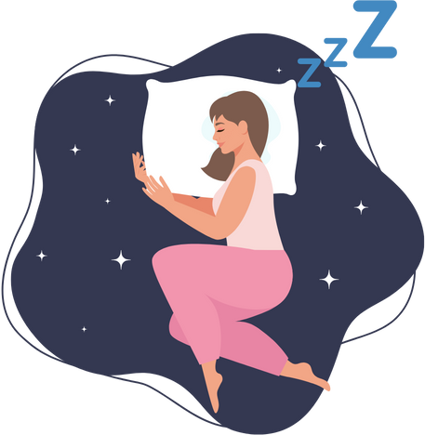
Strategies for Managing stress: Protecting sleep
What is sleep good for?
ABSOLUTELY EVERYTHING
Notes:
Sleep is often the first thing that gets impacted when we are stressed and protecting your sleep is actually a way to manage stress. Having good sleep hygiene is beneficial because it affects everything about our health.

Slide 17
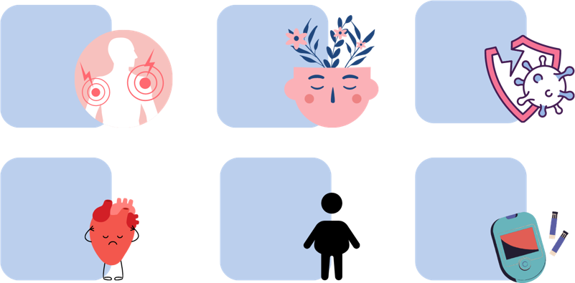
Consequences of insufficient sleep
Pain
Perception
Mental
Health
Increased
hunger
Lowers the
Immune System
Detrimental for
cardiovascular
health
Glucose dysregulation
Diabetes
Higher A1c
Obesity
Visceral fat
Insulin
resistance
https://www.sleepfoundation.org/sleep-deprivation,Mesarwi et al., Endocrinol Metab Clin North Am. 2013
Reutrakkul and Cauter. Metabolism 2018, Greer et al. Nat Commun. 2013; Vidafar et al. Nutrients 2020
Notes:
There have been a lot of studies on the physiological consequences of insufficient sleep, and here is a list of just some of the physical and mental effects of sleep deprivation found in research.
Mentally, it slows our thinking, and reduces our attention span.
There are also links to physiological effects such as pain perception, cardiovascular disease, insulin resistance and diabetes as well as a decreased immune response to infections.
There are higher rates of obesity in people with insufficient sleep.
Researchers believe that sleep deprivation impacts the central brain which governs food desire and appetite , altering what kinds of food people crave (increasing drive to consume more palatable foods) and increased food consumption.

Slide 18
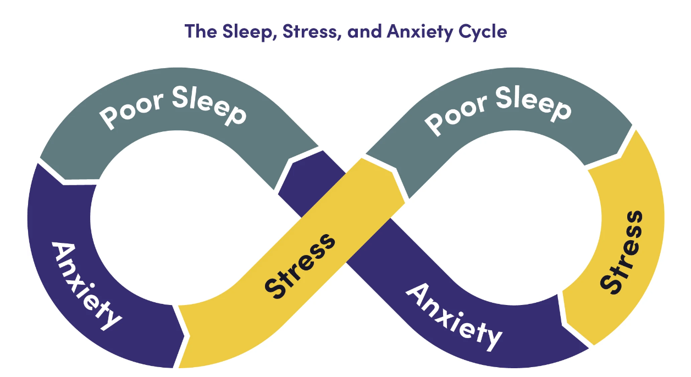
Sleep and stress and emotions
Yoo et al., 2007
Minkel et al., 2012
Notes:
When people don’t have enough sleep this can affect many aspects of our lives our ability to cope with stress and it affects the part of the brain called the amygdala which regulates our emotions, making it excessively active.
Studies have shown that even having just one less hour per night of sleep has been associated with less positive emotions. This means that when you do not get enough sleep – you will perceive events to be more negative than if you had enough sleep.

Slide 19
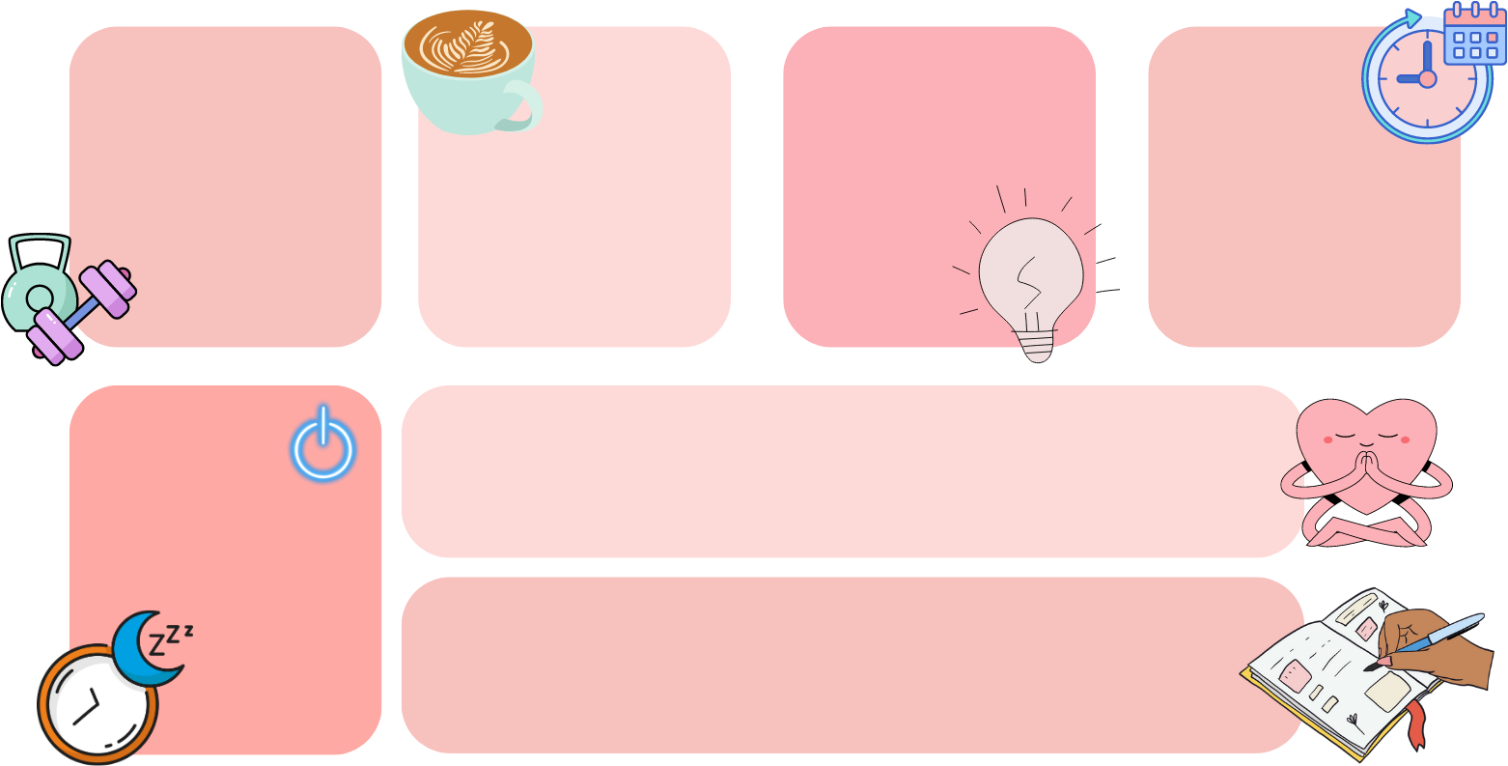
Protect your sleep
Exposure to light in the morning (sunlight is best), and dim lights
in evening
Regular physical activity​
Wake up at the same time every day, go to sleep when you first start to feel sleepy
Avoid caffeine
8-10 hours prior to bedtime
Avoid eating prior to sleep
Unplug 2 hours prior to bedtime (set an alarm)
Do something relaxing to get your body in the mood for sleep (Reading, listening to music, meditation)
Take care of your emotions before you go to bed (spend 5 minutes writing things down in a journal a few hours before bed)
Sleepfoundation.org
Notes:
So the message here is that sleep is really important for your health and we need to protect it. Most adults need about 7-9 hours of sleep per night.
Regular physical activity can help regulate our sleep, as well as avoiding to much caffeine close to bedtime, light exposure, unplugging 2 hours before bedtime, and doing something relaxing before bed.
Maintaining a stable wake time is particularly important.
Waking up at same time every day can be helpful to reset your sleep cycle
Journaling a few hours before bed to take care of the emotions or racing thoughts has been shown to improve sleep.
If you wake up in middle night, don’t stay in bed. “Brain dump” on paper then go back to bed when tired.
You don’t want to have association with being awake and staying in bed

Slide 20
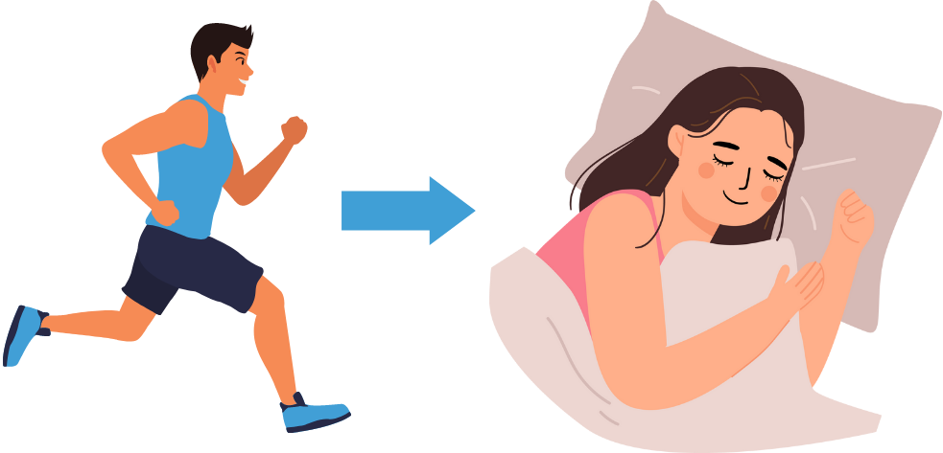
Physical activity and sleep
Daily activity is critical to ensure a restful night sleep
Exercise has been linked to enhanced slow wave sleep (restorative sleep)
Slide courtesy of Dr. Aric Prather PhD
Notes:
The relationship between exercise and sleep has been extensively investigated over the years, and increasing exercise can have a positive impact with more restorative sleep. Not only can exercise help you sleep better, but getting an adequate amount of sleep may promote healthier physical activity levels during the day. Recent research has shown that insufficient or poor-quality sleep can lead to lower levels of physical activity the following day.

Slide 21
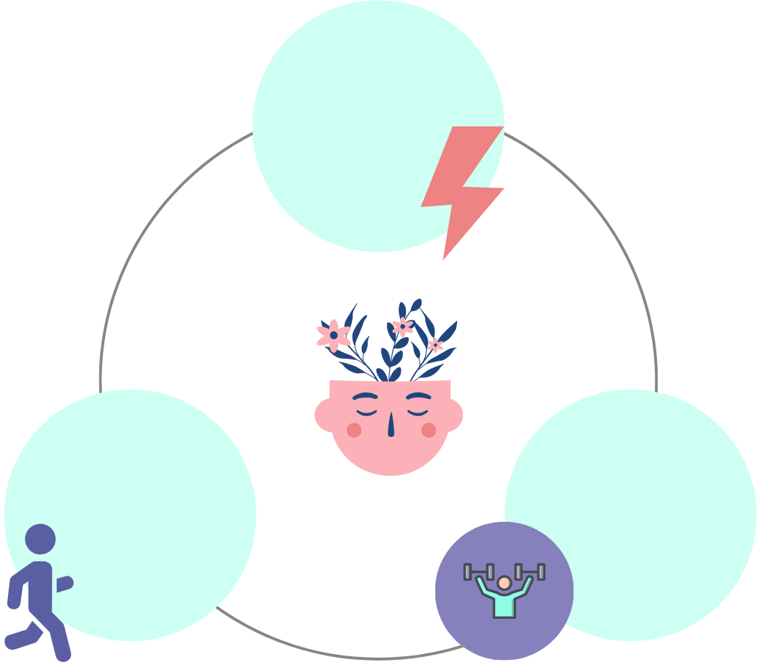
Physical activity helps with stress resilience
Improved energy
Aerobic exercise reduces
anxiety, depression
heart rate
High intensity exercise or exercise snacks and improves well-being
Learn more by reading: Epel, E 7 Days to More Joy and Ease The Stress Prescription
Notes:
There are many other emotional, physical and mental benefits of aerobic and high intensity exercise or HIIT- discussed in session 5
Not matter what type of HIIT you choose based on your physical capacity or experience, find your edge where you feel some discomfort or struggle. This will trigger release of hormones and chemicals in your brain to increase your stress and emotional resilience (improved depression)

Slide 22
Group exercise: sleep habits
Do you have trouble with your sleep habits currently?
Based on this section on sleep, what sleep habits would you like to target?
Examples of SMART goals:
I will practice writing in a journal for 5 mins at 8 pm three times a week for the next two weeks
I will go to bed right when I am feeling sleepy 5 times per week
Notes:
Do you have trouble with your sleep habits currently? If so – is it important for you to change your sleep habits?
Based on this section on sleep, what sleep habits would you like to target?

Slide 23
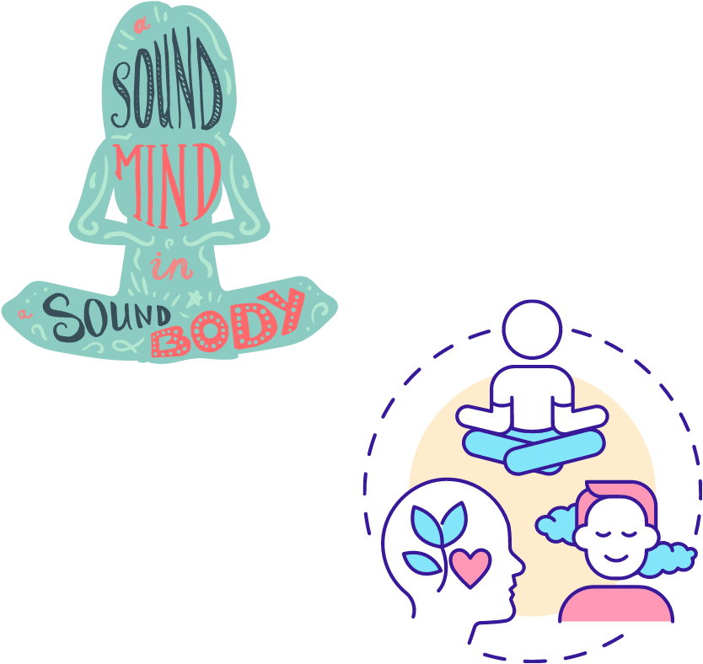
Relaxation and tuning in to our bodies
Being in the present: a muscle that needs constant strengthening
  Diaphragmatic breathing
  Meditation,guided imagery
  Closing eyes and focusing on joyful moments
Other practices discussed in previous sessions:
  Mindful eating
  Exercise/movement
Notes:
Refer to handout provided on resources for relaxation, mindfulness and being in the present.
Show how to do diaphragmatic breathing

Slide 24
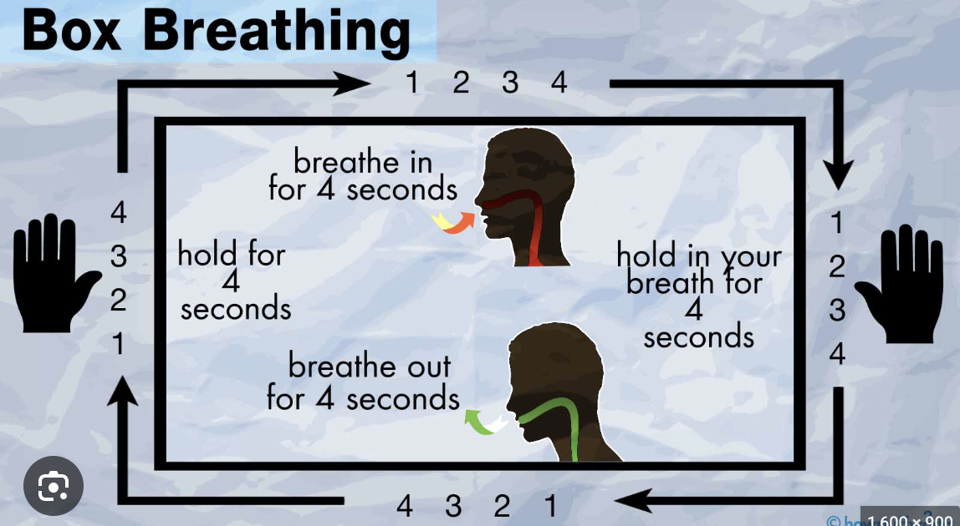
Box Breathing
Notes:
Describe this as a simple method of controlling your breathing and focusing attention on the body which is a form of medititation
There are many other methods: breath in for 4, hold for 6, breathe out for 8.

Slide 25

Resources for stress management
Apps
  Reveri (free)
  Insight Timer (free)
  The Breathing App (free)
  Smiling Mind (free)
  Stop, Breathe & Think (free/$)
  Headspace ($)
  Calm ($)
https://self-compassion.org/
Sleepfoundation.org
www.mindfulwaythroughanxiety.com
UCSF Osher Center
  Mindfulness-based stress reduction (MBSR)
  Laughter yoga
  Guided imagery and meditation audio recordings
  Integrative psychiatry and psychotherapy
Individual therapy
Notes:
Here are resources for Site for osher audio:
https://www.healthjourneys.com
Breathe2Relax, InsightTimer, Calm
has mindfulness exercises tab

Slide 26


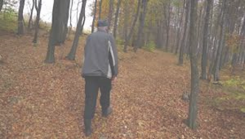
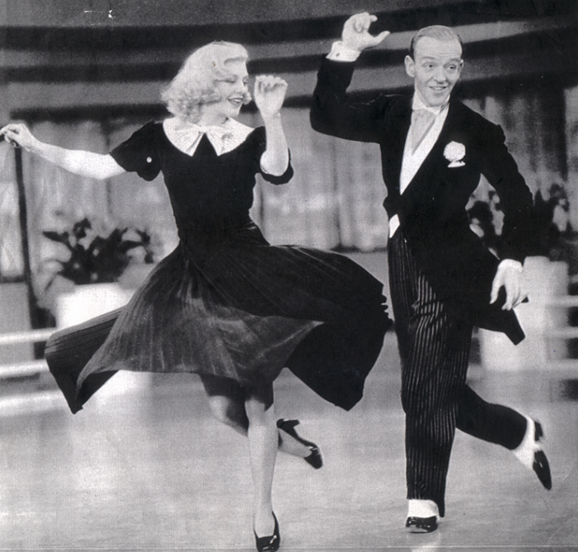
Benefits moving in nature and through dance
  Reduced anxiety
  Reduced depression
  Improved sleep
  Improved thinking
  Improved energy and joy
  Improved response to stress
Epel, E The Stress Prescription
Notes:
Being in nature, walking in the outdoors and dancing have similar benefits and can help all of these things.

Slide 27
Information support
Emotional support
What kinds of support do I need?
Esteem support
Who in my life provides this support?
Instrumental support
Social Support
Social support can buffer the harmful physical and mental impacts of stress
Higher perceived support improves health and longevity
  Identify types of support systems
  Cast wide network
  Spread out support
Notes:
Finally, social support can buffer the physical and mental impacts of stress—and higher perceived support (having the confidence that we are supported by others) improves both mental and physical health and increases longevity.
Social support is multi-faceted.
Significant others, family and friends are usually a big source of emotional support and instrumental support, or taking the burden off your shoulders in time of need.
Other kinds of support are like the support network in group programs like BRIDGE where there is empathic understanding, sharing of information and encouragement from others who face similar health challenges
Other networks of support include people in a church community, work environment or the gym, where people encourage and build confidence and self-esteem
It’s helpful to identify and access the different support systems, cast a wide network and spread and spread it out.

Slide 28
Asking for help can be hard
Asking for support from others is sometimes not easy
  They may disappoint you or say no, or they may not understand the importance
  Try to avoid overthinking
Gratitude is an important part of receiving support from others
Being a source of emotional support for others can be empowering and affirming
Notes:
Asking for support from others is sometimes not easy. They may disappoint you or not understand its importance to you. Try to avoid overthinking it and instead think of how to handle the disappointment and try again

Slide 29
Group Exercise: Reflections
Think about the main sources of stress in your life right now
What works best for you to cope with stress in the moment?
Who gives you support, and do you need to other types of social support?
SMART goals examples:
Do breathing exercise once daily
Take walks in nature once per week
Evaluate once a week if I need more support, identify what type of support I need, who can I ask for support, plan and take small steps, congratulate myself for taking the risk.

Slide 30
Closure
  Reflect on your experience, share perspectives on the series…
  What will you take away from this time spent together?
Notes:
Acknowledge and share perspectives on the series. What you have learned from educational part, and what will you take away from the time spent together.
If appropriate invite members to project to 3 months from now and think about how things will be.
Invite members to focus on themselves rather than the program (they will be receiving a questionnaire and opportunity for written feedback)

Slide 31
Acknowledgments
Psychology consultant for BRIDGE: Simone Madan, PhD, clinical psychologist, UCSF Weight Management Program
Jamie Cohen PsyD. Attending Clinical Psychologist, Psycho-Oncologist and Survivorship Wellness Group Program facilitator
Sleep slides courtesy of Aric Prather PhD Associate Professor of Psychiatry and Behavioral Sciences UCSF
Noemi Hoffer MA, MCHES, Program Manager, Sheri Sobrato Brisson Brain Cancer Survivorship Program at UCSF
Asal Bastani BS and Leena Usman BS for Power Point support.

