Slide 1
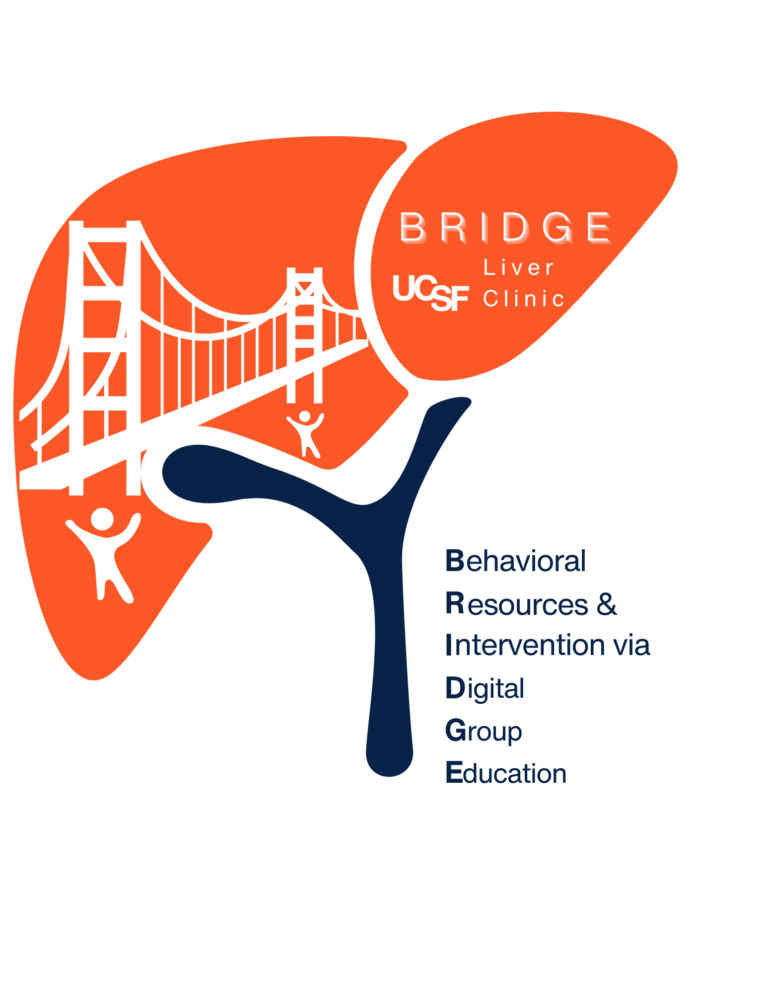
BRIDGE Session #3
Motivation and Making Change

Slide 2
Check-in
Thinking about your behavior change goals in nutrition/diet, exercise/physical activity or sleep habits at the last session:
  What went well for you in these past 2 weeks?
  What were the challenges?
  Was this expected or unexpected?
Notes:
For the check-in this week I’d like us to think about the goals that we started to talk about last session. Do you remember the goal tracker that we talked about – did you use this?
Whether or not you have been consistent about the goal, what is important is that you identified something to change.
These are initial steps toward your goals and this will continue to be a work in progress, because taking small steps can create momentum for change and is movement in the direction of change to increase your confidence.
What has gone well for you over the past 2 weeks?
What got in the way if anything? Were there any setbacks or challenges and was this expected or unexpected?

Slide 3
Today’s focus: moving through change
Goal for today’s session is to talk about:
  What drives us to change our habits
  Why change can be difficult
  What might stand in the way of change
  What we can do if we “relapse” or revert to old behaviors
Stages of Habit Change Model
Notes:
The educational focus of the group so far has been on your liver condition, and as you know the management really hinges on lifestyle habits to promote a healthy weight. We started talking about the “why”, or what drives us to make a behavior change to improve our health and that’s going to be the focus of today’s session, while also talking about how it can be difficult. Some of you have already made changes and working on maintaining those things to avoid reverting back to old behaviors <CLICK> We will be looking at the Stages of Habit Change Model to help us understand ourselves better when we are working on changing habits.

Slide 4
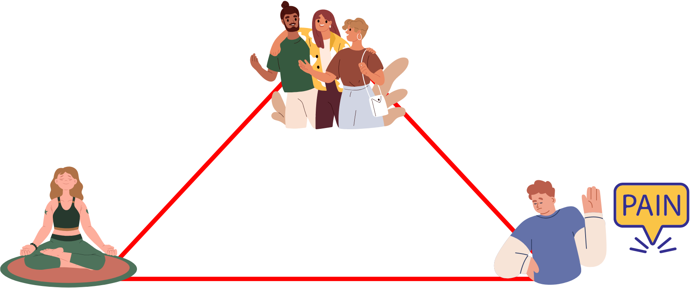
Motivational Triad
Seek pleasure
People often act out of habit even when it’s in conflict with what they want.
Motivational Triad
Conserve energy
Avoid pain
Notes:
So why is making changes in our habits so difficult? This image of the motivational triad helps us to understand what drives our behavior as humans from a survival stand-point. Our brains developed to live our lives habitually, finding the road of least resistance, to avoid pain or things that don’t make us feel good, and to try to conserve energy. We often act out of habit, even when it’s in conflict with the outcomes we want.
*************************
In the caveman days, the earliest humans had a harder time surviving, we had to work hard to get food. In our life in modern times--We don’t need to expend much energy to survive. We have an abundance of food that is readily available everywhere, and plenty of the kinds of processed foods that can provide us with pleasure. To avoid dangers from predators our brains developed in a way that instinctually tells us to avoid pain/things that make us not feel good, and try to conserve as much energy as possible. Pain from exercise is often undesirable, and this works against our desire to exercise or increase physical activity. Finally our brains are wired to conserve energy, working against our motivation to put energy into food preparation and encourages us to be more sedentary. Change requires conscious effort and breaking these instincts.

Slide 5
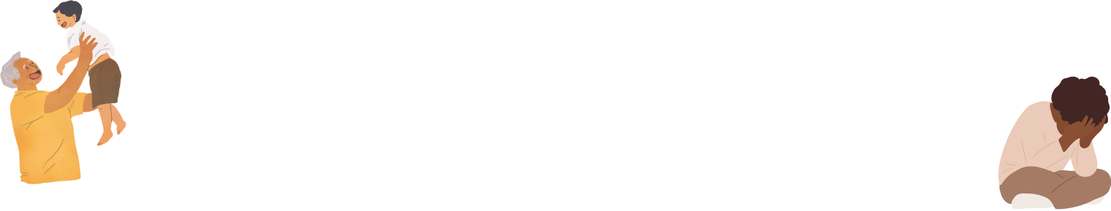
What drives us to change behavior?
Values
What is important to us
  Our health, vitality
  Being there for our family
Fears
“Jolt” into action
  New diagnosis
  Health event or scare
Recognize value of habit change
Willingness to face discomfort to make habit change
HOW IMPORTANT?
Gradual changes, not too demanding
HOW IMPORTANT?
HOW CONFIDENT?
Notes:
What makes us motivated to change our behavior? Usually, changing our behavior is driven by either our values or by our fears.
In the last session we talked a little about some of our values in life (like our health/vitality, being there for our family) and what those values make us “do”. For example: “I value my health and feeling good inside my body, so it’s important for me to eat a healthy diet”. So its helpful to think about deeper values in life and align them with our health habits (because when they are aligned, we are more likely to adhere to those habits in the long term). Very often, what motivates us to make a behavior change is also valuing the result that it will bring to us.
Another important motivator is fear. For many people a new diagnosis or health event can cause fear/anxiety. This fear can serve as a powerful motivator to make change, “jolting us into action”. However, too much fear can also be unhelpful or even paralyzing, and therefore counterproductive.
Let’s look at an example of increasing physical activity:
I can recognize the value of increasing physical activity because it will make me feel more energetic, while the other side of this is asking myself how willing I am to face the discomfort or energy needed to start doing it? These are questions we ask ourselves when we are thinking about the degree of importance.
Thinking about how confident I am in increasing physical activity, I can with small steps. For example: how confident am I that I will walk, say, 20 minutes per day– at least 8/10 confidence? If I give myself only a 5 out of 10, then I may need to break the behavior change goal into a smaller step that I’m highly confident that I can do, ie: start with 10 minutes per day instead
Optional example:
Another example of giving up on a not so good food choice, like stopping soda drinking.
I recognize that I am giving up soda drinking is an important step because I understand it can reduce the amount of sugar in my diet and it’s important for liver health; If I am willing to face the discomfort of giving it up, I am deciding how important it is for me to stop drinking it. If I am not willing to give them up all at once, or don’t feel confident in completely eliminating it all at once, I can decide to make small gradual changes in a step by step fashion, like reducing the number of times per week I drink soda, so that it is not so burdensome. Doing this in a step wise process allows us to be more confident in our ability to achieve our goals, and it will be much more likely for us to make it happen, instead of anticipating failure.

Slide 6
Stages of Habit Change Theory
Habits: activities, food and sleep
Notes:
Change is not something that happens overnight. It happens in a series of steps – or STAGES

Slide 7
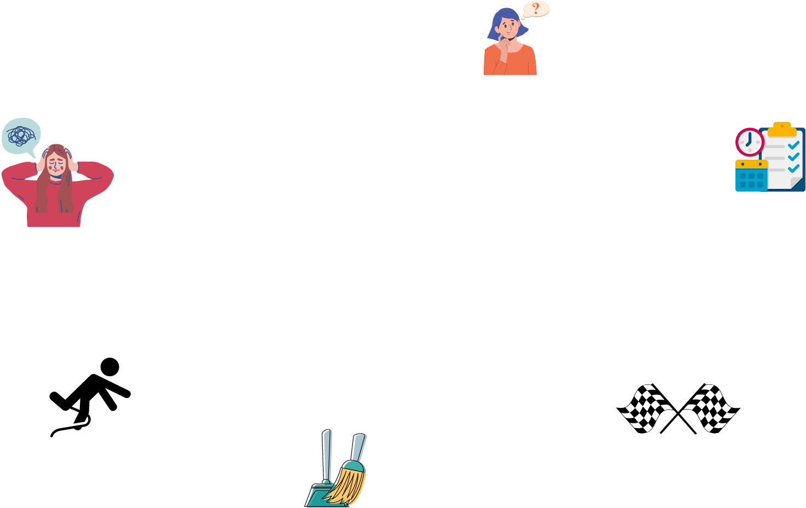
Stages of Change Theory: Pre-contemplation stage
Enter
Pre-Contemplation:
Denial
Overwhelmed
Unaware
Notes:
Pre-contemplation stage is the initial period of not being ready for a habit change or unaware of needing to change. It can represent that someone is in denial of a problem, feeling overwhelmed.
In this stage, the value to change the habit is not recognized or low. Some people may not be ready to even think about changing because they are not worried enough about it, or they are too anxious or fearful about the issue. There may also just be too many competing priorities and person does not have ability to make changes at this point.
If someone feels “stuck” in this stage, it might be helpful to do some journaling to think about what is getting in the way. Is it fear, avoidance or feeling overwhelmed? Maybe it is prior failed attempts at behavior change and feeling hopeless? You may find that you are not ready to make change yet. If this sounds like you, please talk to your provider…
Holds back: Not ready, hopelessness from previous failure, limiting what’s possible
Moves forward: knowledge, recognizing benefits of change

Slide 8
Stages of Change Theory: Contemplation stage
Enter
Contemplation:
Ambivalence
Pros and cons
Pre-Contemplation:
Denial
Overwhelmed
Unaware
Notes:
The stage of contemplation is thinking about change. This is the stage that many people are in because it’s hard to make changes in habits. There is usually ambivalence at this stage, or mixed feelings about changing something, with contradictory thoughts about change. In this stage we are thinking about the pros/cons of making change.
Holds back: motivation, competing priorities, fear of change or not able
Moves forward: learning new perspective or knowledge, feeling inspired about new possibility

Slide 9

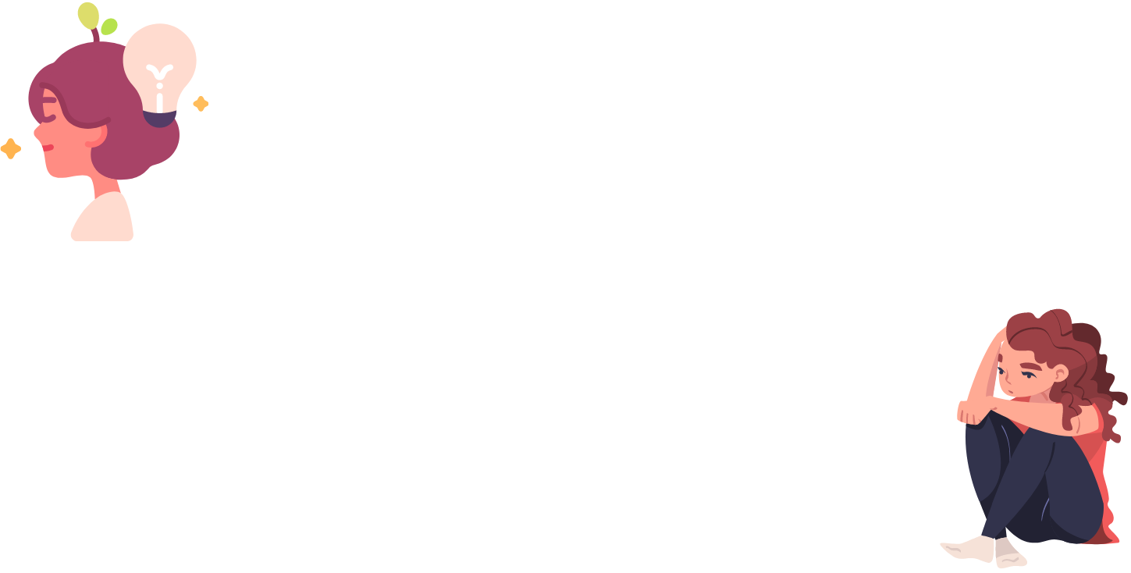
Circle of Ambivalence
Open vs Not Open to Change
OPEN TO
CHANGE
NOT OPEN
TO CHANGE
Notes:
We think about ambivalence as a mental back and forth about changing a habit, or being open to change versus not open to change on a continuum. Both opposing sides exist at the same time, and on the continuum, one side predominates more than the other.
Example: keeping food diary/food tracker… some may be not at all be open to it for various reasons– but some find that tracking food intake works well for them and are more open to starting this habit. (may ask group at this point if any currently using this)

Slide 10
Understanding and Moving Past Ambivalence:
Voicing Pros and Cons
Considering starting exercise program: i.e., brisk walking x 15-20 minutes per day
 | CONS | PROs
Stay the same | Will not improve fitness Might not lose weight I may not get benefits from exercise Worsening liver disease | More time to get my work done I won’t get out of breath or get sore muscles Don’t have a schedule
Change | Another thing to do Getting sore or out of breath Less time to do other things | Improved Physical fitness Improve liver health Sustain weight loss Improve my mood Improve sleep Feel good about myself
Notes:
How can we move past ambivalence ?
One way is to explore thoughts and feelings about a specific behavior change that can help you voice all sides of making a change rather than just defending the status quo. It helps us to carefully determine the balance between the pros and cons, to determine what we’re willing to do and if it’s in alignment with our value-based goal.
Let’s look at a specific example of how we can move past ambivalence about starting an exercise program of brisk walking every day.
If I don’t do anything or stay inactive, then the cons are that I wont get the health benefits. The pros are that I have more time to do other things.
If I do start something, then I’ll have to feel the pain of it, and have less time to do other things. The pros of starting an exercise program are health benefits, as well as improved mood/sleep and feeling overall better.
Ask participants to choose a behavior expressed today or use example of keeping a food diary.
Summarize the cons of staying the same and the pros of changing–
Debrief by asking members to mention something they notice on the chart that is meaningful to them.
- If they identify something on the pro-change side, how can they use that to support making a change? The pros of changing may represent the motivation for change
- If they identify something on the status quo side, how can they overcome that or compensate for its loss by replacing it with something that fills the void?

Slide 11
Stages of Change Theory: Preparation stage
Enter
Contemplation:
Ambivalence
Pros > Cons
Pre-Contemplation:
Denial
Overwhelmed
Unaware
Preparation
Monitoring
Planning
Increasing confidence Identify resources
Notes:
When the pros of making a change outweigh the cons, we move into the preparation or planning stage.
Tasks:
Self monitor and noticing a habit you would like to change, learn its patterns and its data to understand why/how/when happens
Goal setting: Thinking about the details or small steps of changing a habit-- Transitioning from the big picture thinking on what value the change would bring us
Holds back: underestimating preparation, and not taking steps needed prior to action
Moves forward: getting help, being specific, telling friends

Slide 12
BRIDGE Goal Tracker
Habit change goal Importance (scale of 0-10) | My Goal(s)* | What am I doing now | Possible Obstacles | Ways to overcome obstacles | My Challenges and Successes
Dietary habits ___ (0-10) | What: _________ Where:_________ When and how often: __________ How long or how much: _________ When will you start: __________
Physical activity ___ (0-10) | What: _________ Where:_________ When and how often: __________ How long or how much: _________ When will you start: __________
Sleep Habits ___ (0-10) | What: _________ Where:_________ When and how often: __________ How long or how much: _________ When will you start: __________
Thinking patterns ___ (0-10) | What: _________ Where:_________ When and how often: __________ How long or how much: _________ When will you start: __________
Social Support ___ (0-10) | What: _________ Where:_________ When and how often: __________ How long or how much: _________ When will you start: __________
Notes:
Our goal tracker is a good tool for you to clearly identify some specific habits that you can work on, understand what the obstacles are and how you can potentially overcome them.
By identifying potential obstacles –we are creating a plan to address what life throws at us when we are making our plans.

Slide 13
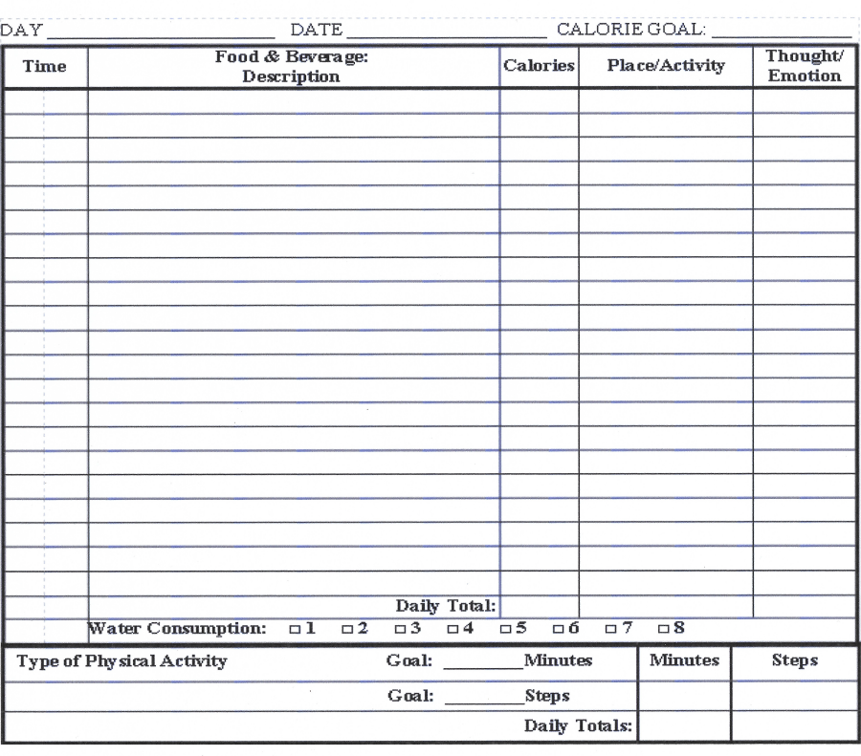
Food diary
Notes:
Food diary is a way to self monitor what you’re eating

Slide 14
Stages of Habit Change Theory: Preparation stage
Making SMART goals
Break down large goals into smaller, actionable items that you can do daily. Focus on where/what is in your control.
  S = Specific
  M = measurable and meaningful
  A = attainable or “do-able”
  R = realistic
  T = time-bound
Notes:
What’s the best way to set a goal? Setting a SMART goal breaks things down to to smaller, actionable items or SMART goals which are specific, measurable, attainable, relevant and time sensitive.
Optional:
Specific: specify the actions you will take, when and where you will do so, and who or what is involved. Example of a vague or non-specific goal: “I will spend more time with my kids.” A specific goal: “I will take the kids to the park on Saturday to play baseball.” A non-specific goal: “I will be more loving towards my wife.” A specific goal: “I will ring my wife at lunchtime and tell her I love her.”
Measurable or Meaningful: The goal should be personally meaningful to you. If it is genuinely guided by your values, as opposed to following a rigid rule, or trying to please others, or trying to avoid some pain, then it will be meaningful. If it lacks a sense of meaning or purpose, check in and see if it is really guided by your values.
Attainable: Does the goal help you to take your life forwards in a direction that, as far as you can predict, is likely to improve the quality of that life?
Realistic: The goal should be realistically achievable. Take into account your health, competing demands on your time, financial status, and whether you have the skills to achieve it.
Time-bound: to increase the specificity of your goal, set a day, date and time for it. If this is not possible, set as accurate a time limit as you can

Slide 15
Stages of Habit Change Theory: Preparation stage
Examples of SMART goals
Improve Nutrition
On Monday through Friday this week I will add ½ cup vegetables at lunch and 1 cup cooked vegetables at dinner
Get in Shape
To jumpstart my exercise routine, I will walk/jog on the treadmill for twenty minutes on Monday, Wednesday and Friday this week before 8:00AM.
Not so stressed out
To help me better manage my stress, over the next two weeks I will find at least five minutes every morning to meditate.
Notes:
Examples of SMART goals
Nutrition:
S: quantity of veggies
M: amount of veggies
A: doable goal
R: veggies = nutrition
T: Mon-Fri
Weight loss is not part of the strategies of SMART goals. Weight loss would be an outcome. When using SMART goals we are talking about changing habits that will hopefully lead to us achieving the desired outcome.

Slide 16
Stages of Change Theory: Action stage
Enter
Contemplation:
Ambivalence
Pre-Contemplation:
Denial
Overwhelmed
Unaware
Preparation
Monitoring
Planning
Increasing confidence Identify resources
Action
Putting the plan into action. Taking steps towards achieving change.
Notes:
After the Preparation stage comes the Action stage, or putting the plan into action and taking those steps toward change.
TASKS:
Implement SMART goals
You will encounter barriers, then we need to address the barriers
It is important to know you A,B,Cs at this point.
Moves forward:
Social support can be key in this phase to help you take the first step.
- focus on actions not outcomes
This stage is really about putting plans into play, making the actual change
Again – at this stage do not worry about results
- it is more about action and behaviors
Holds back: expecting results too quickly, resistance to change, feeling inept, slipping back to old habits, insisting on perfection

Slide 17
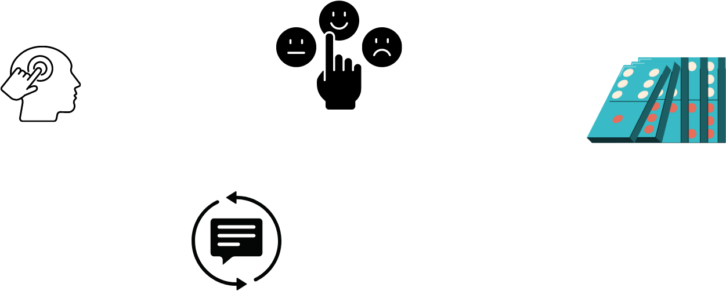
ABC Model for Positive Habits
Antecedent
“Triggers” or cues
Thoughts, feelings
situations
Behavior
Consequence
PAUSE
NOTICE
triggers
CHOOSE
Alternative thought/behavior
Feedback
Repetitive habits create feedback loop to help maintain behaviors
Notes:
The antecedent/behavior/consequence model or ABC model is a useful way to understand automatic behaviors triggered by certain situations, thoughts or feelings that can sometimes get in the way of the behaviors and outcomes that we want. An antecedent or trigger can be a chain of thoughts, situations or events that lead to a behavior and consequence.
Leader gives a concrete personal experience as an example.
(Let’s take an example from my own personal experience: when I work long hours at the computer and forget to take breaks to eat, I end up getting super hungry, so I go to the kitchen and grab chips instead of a healthy snack and ruin my appetite for a healthy dinner).
When I pause and notice this chain of events, I can choose to modify the behavior, remembering my values that I want to feel good
It’s helpful to actually visualize all of the steps needed to change the chain of events, to create a new repetitive habit. For example, I can prepare a healthy snack the evening before, I can set an alarm for myself to take a break to disrupt the pattern, and I can create a new repetitive habit to help maintain the outcome that I want.
Elicit examples from group: what is an example that you can think of
**********************************************************
Optional example:
We can use overeating as an example.
1) Antecedents (Before) Events, feelings, and situations before overeating.
2) Behavior (During)Overeating, Speed /Rate of Chewing, Eating is out of control, Fullness from overeating
3) Consequences (After)Events and Feelings after overeating, Situations after overeating
There is a feedback loop built into the behavior, as what happened last time you behaved in a particular way will have an effect on how you will behave the next time. Depending on the consequence, you will either sustain or change your behavior.
Example:
Gretchen is working late at work on Tuesday, she has an important project due by the end of the week. She typically works long hours to avoid going home. She lives alone, her cat recently ran away, and finds the loneliness unbearable. She has been working especially long hours for the last several days and has worked on the weekend too. She is exhausted. Her coworkers have not been working as hard as she is and she’s is angry about carrying so much of the workload. She has not been able to do her grocery shopping for the last several days so she stops by the burrito place and gets a super burrito with “the works”, with chips and an extra serving of guacamole on the side. She eats the chips while driving on the way home. And, gets home, turns on the TV and eats her burrito quickly. Later she feels very full and uncomfortable. She feels like she has blown it and feels angry with herself for eating the burrito and all the chips and being out of control.
A) What are the triggers> working late, deadline, stress, fatigue anger, loneliness, no time, problems with co-workers “I deserve to treat myself”
B) The unplanned burrito, eating chips while driving, eating large amount until very full while watching TV, out of control
C) full, uncomfortable, remorse, stomach hurts, self-criticism, “ I am such a loser, I will never lose weight”
What could she modify the next time?

Slide 18
Are there habits you want to change?
Visualization exercise to increase the likelihood of changing a habit:
To start a new habit: think and write down feelings, thoughts or a series of events that you would do before and after a new habit that you want to adopt—this creates a positive feedback loop in your brain to make it easier for you to do the action.
For breaking a habit: in addition to noticing the antecedents (triggers) you can bring conscious awareness to the period immediately after the unwanted behavior. Choose to do a positive behavior afterwards, to disrupt the pattern
Notes:
Sometimes there are cues to trigger habits– a place, other people or other actions done prior to the habit.
Let’s think about a negative habit> watching TV in the evening makes a person get some ice cream to eat. It affects an automatic action or can affect a throught.

Slide 19
Stages of Change Theory: Maintenance stage
Enter
Contemplation:
Ambivalence
Pre-Contemplation:
Denial
Overwhelmed
Unaware
Preparation
Monitoring
Planning
Increasing confidence Identify resources
Action
Putting the plan into action. Taking steps towards achieving change.
Maintenance:
Behavior becomes a part of daily routine.
Notes:
The maintenance stage is when results are achieved and the behavior becomes a part of the daily routine.
The task of this stage is maintenance of habit change, NOT weight loss
The task is trying to maintain SMART goal which will allow you to maintain the habit change. Sometimes there can be setbacks or triggers that can get us off track, and we need to go back to the preparation stage to monitor, plan and identify resources.
Moves forward: support, stress management, avoiding trigger for relapse
Holds back: Hitting plateau, getting bored or distracted, injury
WHAT DO YOU THINK THE EMPTY BUBBLE IS?

Slide 20
Stages of Change Theory: Relapse
Enter
Contemplation:
Ambivalence
Pre-Contemplation:
Denial
Overwhelmed
Unaware
Preparation
Monitoring
Planning
Increasing confidence Identify resources
Relapse:
Recurrence of the behavior
Action
Putting the plan into action. Taking steps towards achieving change.
Maintenance:
Behavior becomes a part of daily routine.
Notes:
It is always possible to revert back to previous behavior, or “relapse”.
The primary tasks here are to:
cope with the consequence
Understand this is part of the process
Stop behavior as soon as possible
Figure out how to get back on track
With relapse – there are 3 types
Lapse: this is a short term setback. Sometimes people catastrophize it. If this has happens we need recognize the ABC and get back on track
Relapse – This is when we have not adhered to your plan for a longer period of time- again, forgive yourself, recognize the ABC’s, and prepare again.
Collapse – when you have given up and go into denial, feeling overwhelmed.
TASK
Forgive yourself!
Get back on track through ABC’s
Modify your plan if needed

Slide 21
Stages of Change Theory: Relapse
Enter
Contemplation:
Ambivalence
Pre-Contemplation:
Denial
Overwhelmed
Unaware
Preparation
Monitoring
Planning
Increasing confidence Identify resources
Relapse:
Recurrence of the behavior
Action
Putting the plan into action. Taking steps towards achieving change.
Maintenance:
Behavior becomes a part of daily routine.
Notes:
With relapse – there are 3 types
Lapse: this is a short term setback. Sometimes people catastrophize it. If this has happens we need recognize the ABC and get back on track
Relapse – This is when we have not adhered to your plan for a longer period of time- again, forgive yourself, recognize the ABC’s, and prepare again.
Collapse – when you have given up and go into denial, feeling overwhelmed.
TASK
Forgive yourself!
Get back on track through ABC’s
Modify your plan if needed

Slide 22

Triggers for relapse & How to avoid them
Dietary habits:
Increase structure
  Keeping food diary/weekly meal plan
Limit places/activities while you eat (only at kitchen table, do nothing but eat)
Find positive ways to respond to stress, boredom, sadness
  Consider going for walk, calling a friend
Plan ahead for social events
Physical activity habits:
Create a weekly schedule
Let your friends, family, work know that you are busy during that time
Find exercise buddy
Have a back-up plan to prepare for limitations (weather, air quality, injuries)
Sleep habits:
Consistent bedtime
Avoid screens/bright lights before bed
Drinking caffeine earlier in day
Avoid eating close to bedtime
Notes:
It’s helpful to notice what the triggers are.
Here are some examples of things that people do to modify or prepare for high risk situations or triggers.
Dietary intervention examples:
Plan ahead for social events: eat before, offer to bring low calorie meal, practice saying “No thank you” when you are offered foods.

Slide 23
Moving into action: Where are you in the change process?
STAGES OF CHANGE
What health habit(s) are you focusing on?
What stage of change are you in?
What’s moving you forward?
      Core values?
      Fear?
What’s holding you back?
Precontemplation
Contemplation
Preparation
Action
Maintenance
Relapse
  MOVING INTO ACTION: Refer to BRIDGE Goal Tracker to help you to break your goals down into smaller actionable steps or SMART goals.
Notes:
This is a dynamic cycle. You can move through this constantly. You can be in one phase in the morning and by afternoon be in relapse stage

Slide 24
Acknowledgments and Thanks
Simone Madan PhD. Clinical Psychologist at the UCSF Weight Management Clinic who greatly contributed to the development of this session
Jamie Cohen, clinical psychologist and psycho-oncologist and Survivorship Wellness Group Program facilitator (for Goal Tracker).
Noemi Hoffer MA, MCHES, Program Manager, Sheri Sobrato Brisson Brain Cancer Survivorship Program at UCSF(Motivational Triad)

Slide 25
BRIDGE Session 4:
Eating Habits for a Healthy Liver

