Slide 1
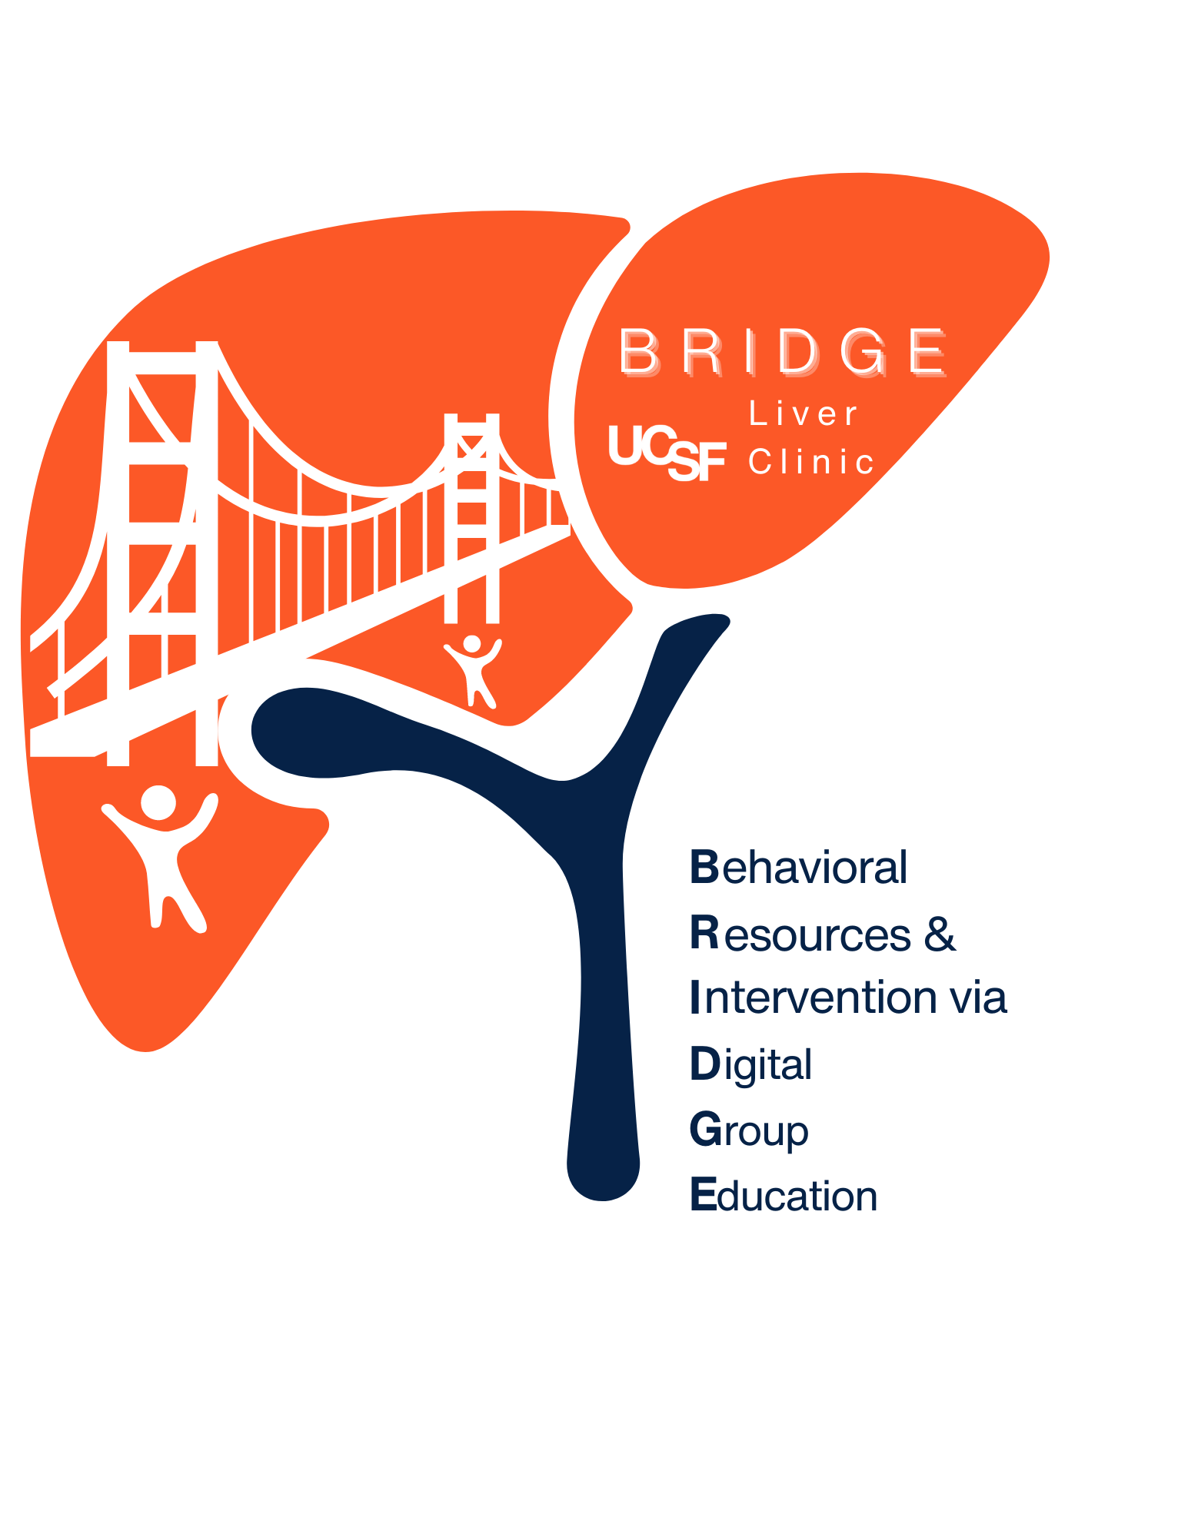
BRIDGE Session #2
Improving Liver Health Outcomes in Cirrhosis
Part II

Slide 2





BRIDGE “ground rules”
Encourage attendance at all 6 sessions-- no penalty for missed sessions
Try your best to be on time
During group discussion Please provide support, not advice (unless asked)
For Q&A: Please focus questions on behavioral aspects of liver health
Participation by all members is encouraged
Mute during didactics
Notes:
Try your best to be on time
We would love to have 100% attendance for each of the 6 sessions, but we understand this may not be possible. Please do let us know if you will not be able to attend. We do want to learn about barriers to sticking to a program such as this.
Participation is encouraged to the extent you are comfortable. No question is silly or stupid. If you are thinking of a question, chances are someone else is as well, so we do hope you will feel comfortable to speak up or write something in the chat.
I as your group facilitator may modulate participant involvement (getting things back on track) make sure we are able to hear unique contributions of all.
The spirt of this program is SUPPORTIVE. I encourage you to talk about your own issues and how they connect with others. You may hear others share their experience; remember that what works for one may not work for another.
Please don’t give advice unless it is asked for. No one here, including me, should try to make any of you change your health behavior; rather, we can best support one another by respecting the decisions of each individual
9

Slide 3
Environment, Life experiences
PAUSE.
NOTICE.
Hot thoughts?
CHOOSE.
Alternative thoughts based on evidence
Thoughts, memories
Physical symptoms
Mood
Health-related behaviors
Notes:
Check in about homework and introduce Pause, Notice Choose
Pause/Notice/Choose is a practical tool that we can use for self-reflection or self-awareness- it's a simple quick activity that we can do every day to help us to notice automatic thoughts or habits that we've developed and to really start to choose alternative thoughts based on evidence.
24

Slide 4



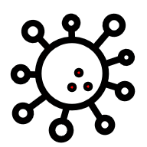

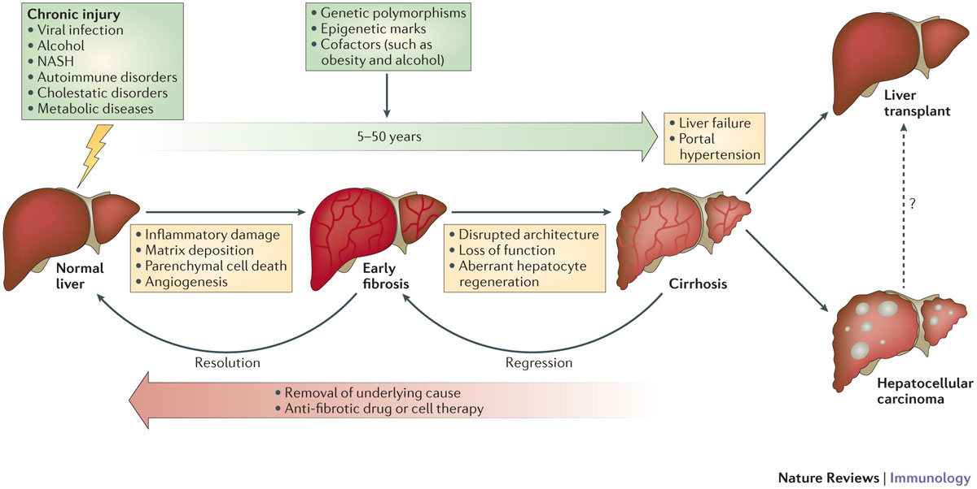



Cirrhosis may regress with removal of liver injury
Cause of liver injury, Genetic and lifestyle co-factors
Lifestyle co-factors may lead to regression
Liver Cancer
Adapted from: Pellicoro et al., Nat Rev Immunol., 2014
Notes:
Last session we discussed how ongoing injury can lead to liver related complications and focused on Liver cancer risk. Today we will be focusing on other liver related complications and how to mitigate the risk for this.

Slide 5
Stages of cirrhosis are highly variable
Compensated cirrhosis
(long asymptomatic stage)
Compensated cirrhosis with
Portal Hypertension
https://healthjade.net/portal-vein/
Development of clinical symptoms
Decompensated cirrhosis
D’Amico et al., J Hepatol, 2022
Notes:
Cirrhosis is a continuum or range of different stages with a lot of variation among people- not always linear
Although there are changes in its architecture from liver scarring, it may still function normally without symptoms for a long time because it’s a very tough (resilient) organ and remarkable ability to bounce back.
“compensated cirrhosis” means that the liver is able to compensate for the damage in it. It’s a long, silent asymptomatic stage that can last for many years.

Slide 6
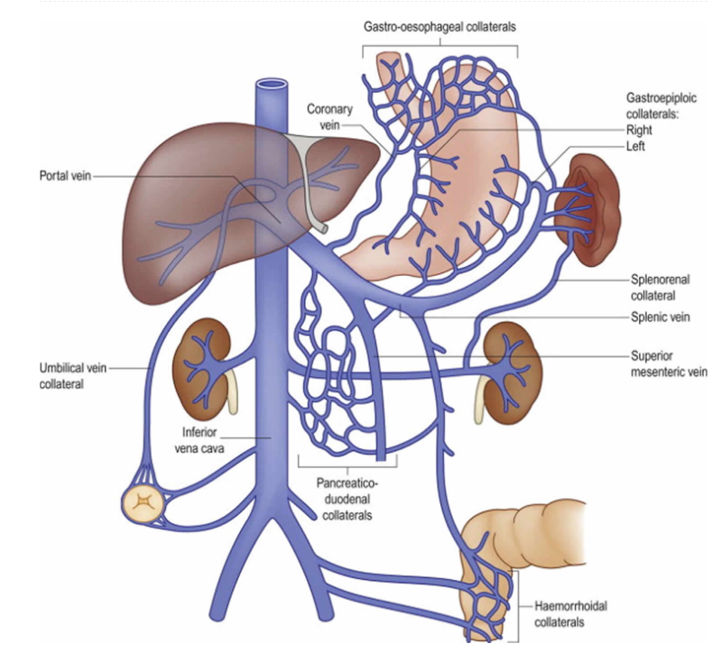
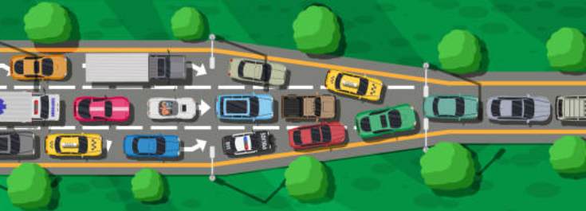
Portal Hypertension drives progression
Systemic view
Compensated cirrhosis
(long asymptomatic stage)
Compensated cirrhosis with
Portal Hypertension
https://healthjade.net/portal-vein/
Development of clinical symptoms
Decompensated cirrhosis
D’Amico et al., J Hepatol, 2022
Notes:
When the liver gets scarred, it becomes hard, blocking the flow of blood through it. Much like what happens in a traffic jam, it can cause a back flow of blood in the portal vein, which is a vessel that carries blood to the liver from the stomach, spleen stomach and GI tract. This is what is called portal hypertension.
Thinking of a traffic jam that leads to more congestion over a long period of time, in portal hypertension, blood can back up into the spleen- causing it to be enlarged (splenomegaly).
And like the cars that will search x alternate routes in a traffic jam, in portal hypertension some new veins start to grow-- These veins are called collateral veins, and they often develop around the stomach and esophagus (or food pipe)
Portal hypertension also is what drives the development of decompensated cirrhosis, or the development of clinical symptoms

Slide 7
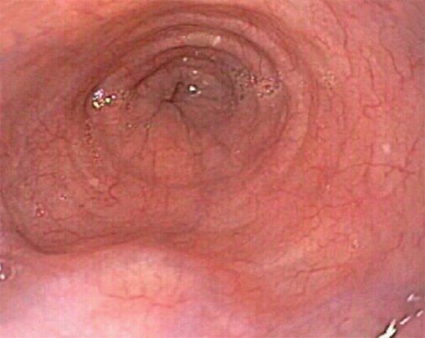
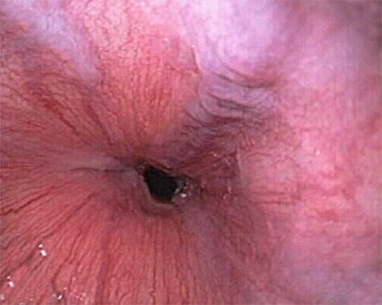
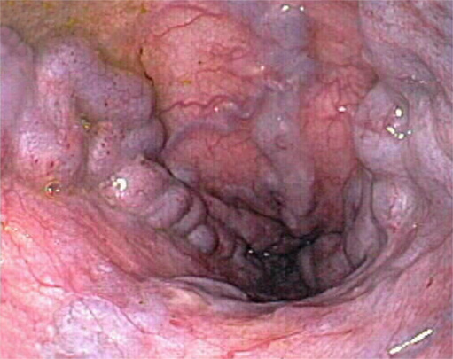

Esophageal Varices & why do they matter?
  Esophageal varices (EV) are enlarged veins in the esophagus and stomach
  EV may be small, medium or large sized.
    Large sized varices with high risk for bleeding
  People with cirrhosis should be considered for an upper endoscopy to prevent bleeding
  Treatment: “Banding” with/without a beta blocker medication
    Nadolol, propranolol, carvedilol
No varices
Small varices
Large varices
8% / year
8% / year
D’Amico G. Portal Hypertension in the 21St Century, 2004
Notes:
What exactly are varices and why do they matter?
Varices are enlarged veins which appear in the stomach and more often in the esophagus (the pipe that goes to the stomach)
They may be small, medium or large in size. When they are large these veins are at high risk for bleeding, which can be life threatening.
45-50% of people with cirrhosis develop varices so people with cirrhosis should be considered for an EGD to prevent bleeding

Slide 8
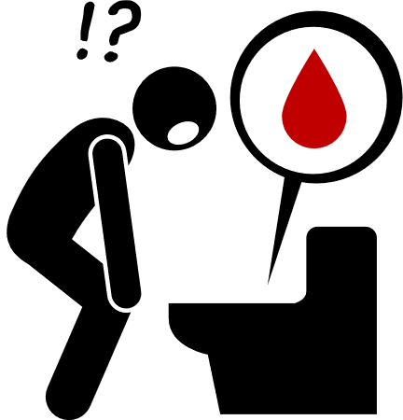

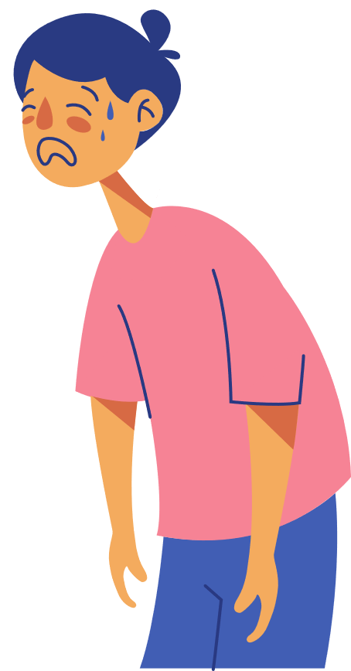
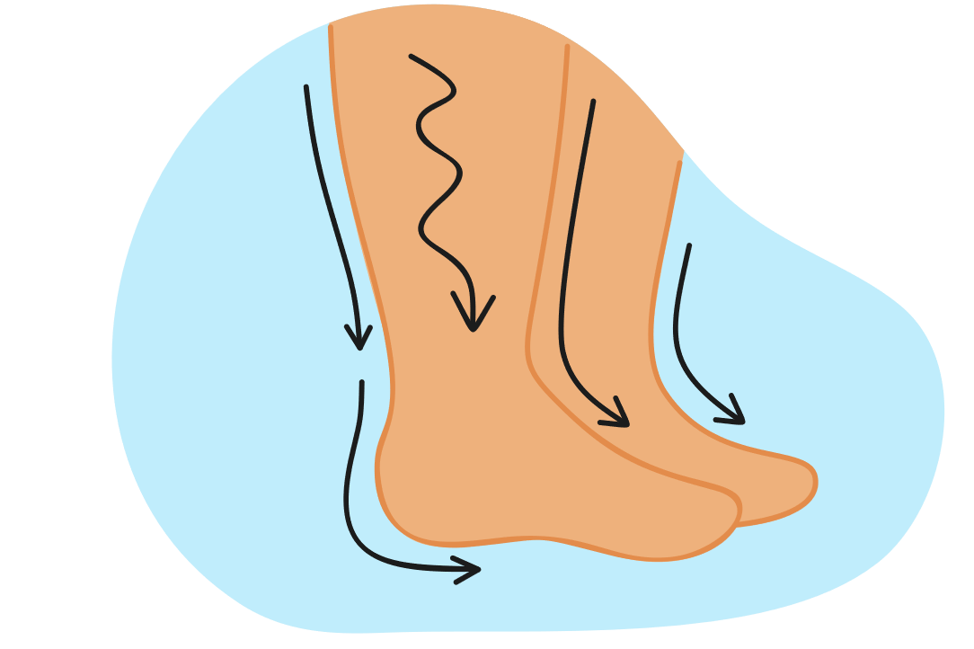
Symptoms of Decompensated Cirrhosis?
  Gastrointestinal Bleeding: most often from varices
    Black or bloody stools/emesis
  Hepatic encephalopathy: Foggy thinking, change in sleep patterns or confusion
  Other organ systems may be affected such as:
    Kidneys
    Bones: osteoporosis
    Muscle wasting
    Fatigue
  Fluid retention/ascites: fluid in legs, abdomen or chest cavity
Notes:
We discussed the potential for bleeding from varices, and your clinician will ask if you’ve noticed black or bloody stools or in throw up. This can be a medical emergency and if you notice any of these symptoms we generally would recommend a visit to the emergency room.
Ascites is fluid buildup as a result of portal HTN and also low albumin in the blood.
Treatment: salt intake should be very low, read labels. Water follows salt. The diuretics are medications that help your kidney to remove fluids by making you urinate more, and require lab tests to check the kidney and electrolytes.
Hepatic encephalopathy is a condition that is caused by toxins (ammonia) build-up in the blood stream and this can range from mild symptoms of foggy thinking and change in sleep patterns to confusion.
Other organ systems may also be affected.

Slide 9
Blood tests may (or may not) change over time
Liver function tests:
Systemic view
Normal liver function tests
Compensated cirrhosis
(long asymptomatic stage)
Mild abnormalities
may occur
Compensated cirrhosis
with
Portal Hypertension
https://healthjade.net/portal-vein/
Development of clinical symptoms
More abnormal:
Albumin
Bilirubin
INR
Decompensated cirrhosis
D’Amico et al., J Hepatol, 2022
Notes:
Blood tests may also change over time.
In compensated cirrhosis, liver tests are normal. Sometimes the platelet count is low, and this can be more pronounced when the spleen is enlarged, however the platelet count is not a liver function test per se.
In the stage where portal hypertension occurs there may be mild abnormalities in liver function tests, and in the decompensated stage we often see the abnormal albumin, bilirubin and INR tests. If you remember from the first session, these tests reflect some of the functions of the liver to produce protein and clotting factors as well as remove blood toxins.
9

Slide 10
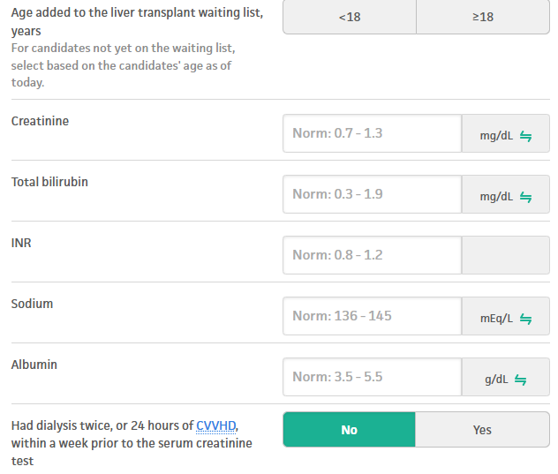
What is the MELD 3.0 Score and why does it matter?
    Model for End stage Liver Disease
      An objective way to measure liver function
      Calculation of bilirubin, creatinine, INR, and sodium
      MELD ranges from 6-40
      Higher MELD indicates worse liver function
      MELD of > 15 may be a consideration for liver transplant evaluation
      Highest MELD = highest priority to receive liver transplant
https://www.mdcalc.com/calc/10437/model-end-stage-liver-disease-meld
Notes:
What is the MELD score and why is it important.
Note about last point: sometimes people with lower MELD are referred for transplant evaluation, based on liver related complications (HCC, symptoms of decompensation)
MELD 15 cutoff varies based on clinical decisions with patient & transplant hepatologist

Slide 11


What can I do to improve liver health outcomes?
Keeping up with your care
Regular follow up with Hepatology or GI provider for:
    Laboratory monitoring and screening for clinical symptoms
    Liver Cancer screening (discussed in session I)
    Endoscopy if indicated, to check for varices

Slide 12

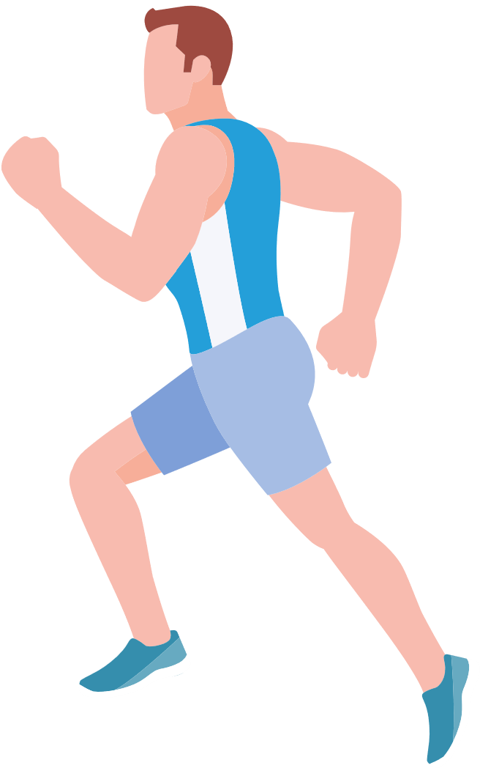
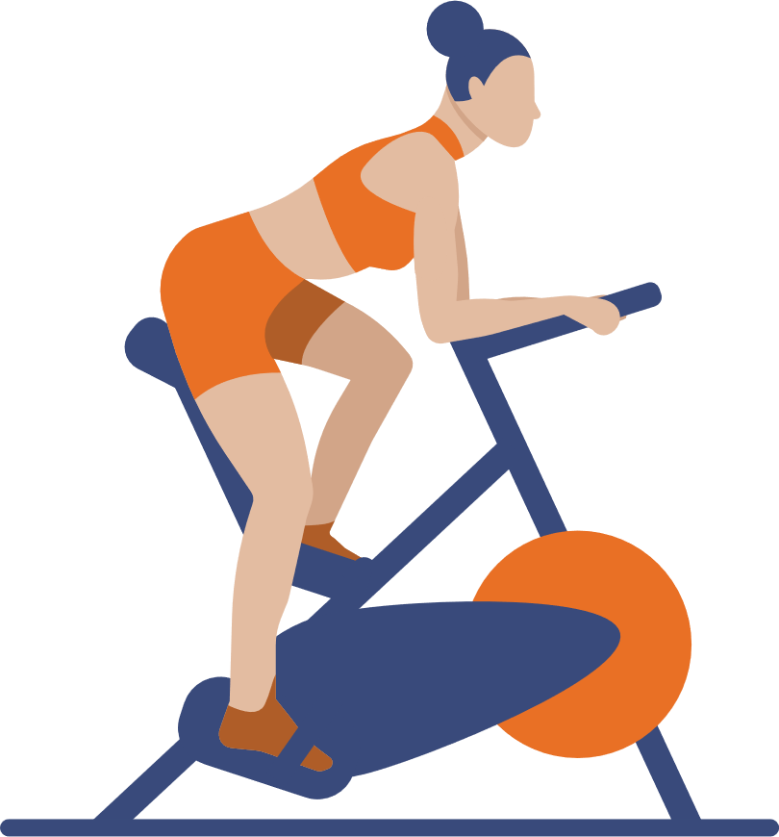

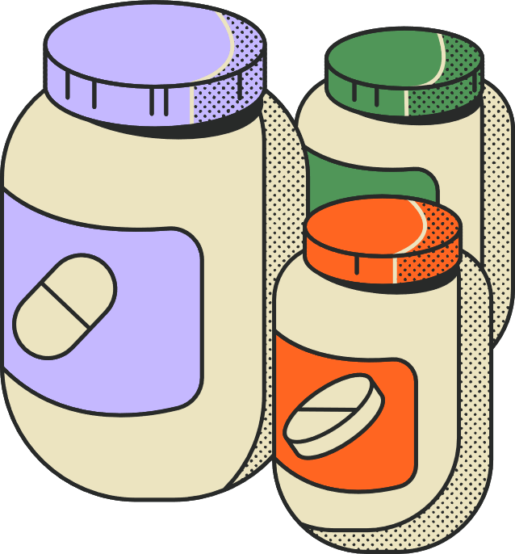
What can I do to improve liver health outcomes?
Lifestyle
  Lifestyle factors to prevent further injury from steatosis (fatty liver)
    Alcohol abstinence: no amount of alcohol is safe in cirrhosis
    Maintain a healthy weight: healthy diet, physical activity
    Control metabolic factors: Diabetes, high blood pressure, abnormal lipids
  Avoid liver toxic substances/ medicines/ supplements

Slide 13

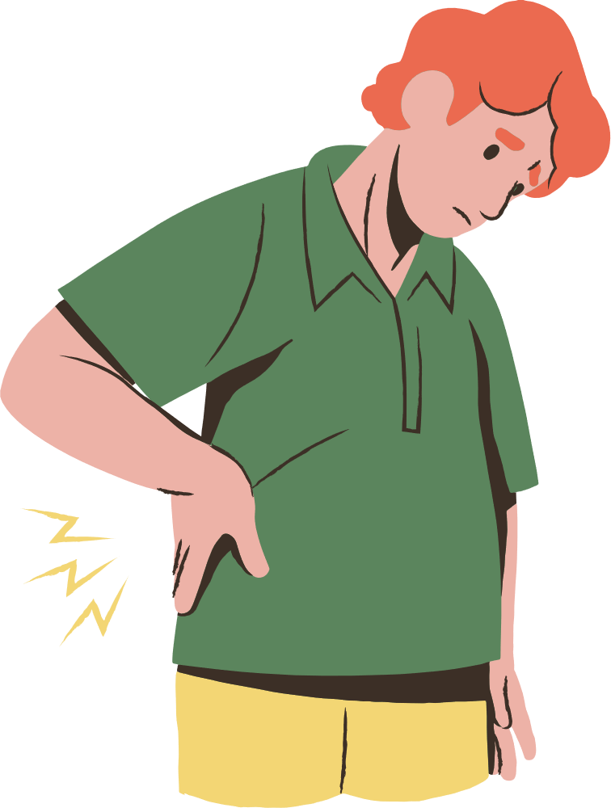
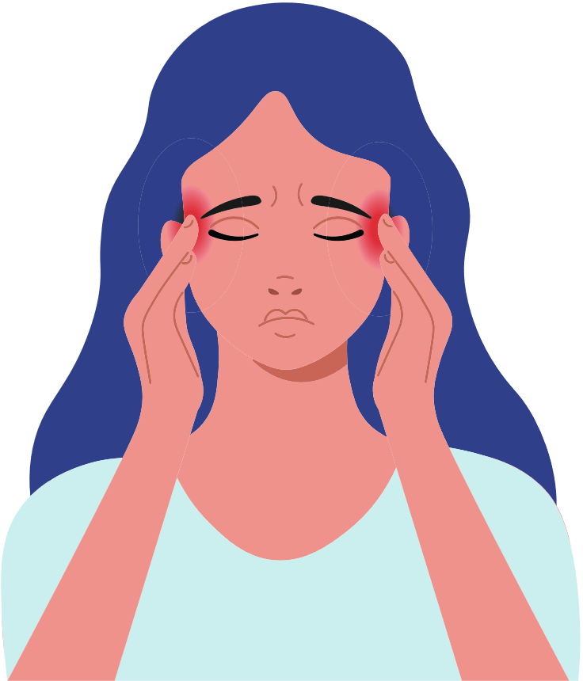





What about medications that I take?
NSAIDS (ibuprofen, Motrin, Advil) can worsening kidney status and increase bleeding risk so generally not recommended
For Pain management:
Avoid medicines/ supplements that may cause liver toxicity
Inform all your health care providers that you have cirrhosis so that they can prescribe medications appropriately
Acetaminophen (Tylenol) is SAFE for the liver in doses up to 2000mg/day in divided doses
Opioid medications or sedatives (benzodiazepines) can worsen hepatic encephalopathy and should be avoided or minimized
Notes:
I want to emphasize pain management here, as many people suffer from chronic pain.
12

Slide 14
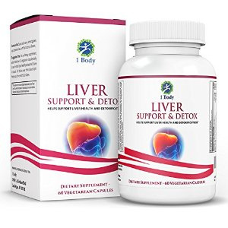
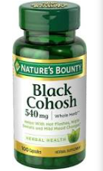
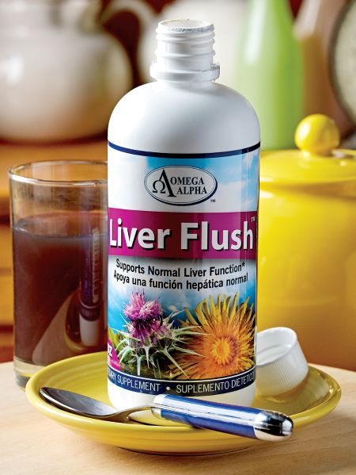

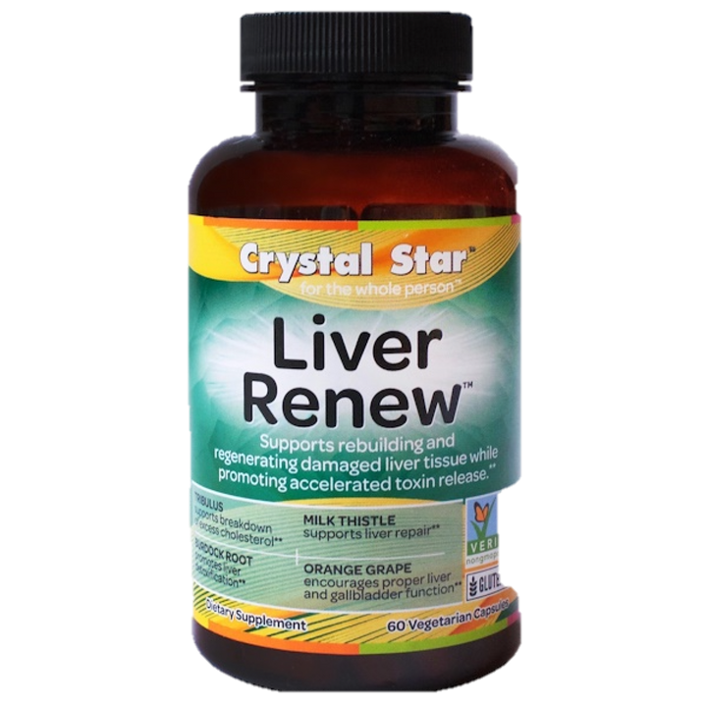
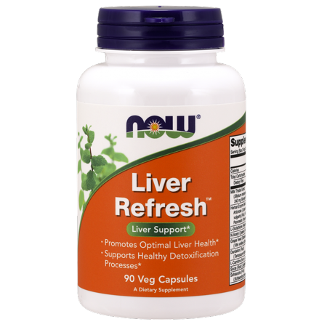
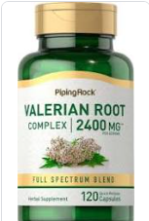
Herbals and supplements may be liver toxic
    Ask your liver provider if you’d like to start any herbals or supplements
    You can check NIH LiverTox website: https://www.ncbi.nlm.nih.gov
Notes:
There are a ton of liver ”detox” agents on the market that are very popular. However, these agents do not have high quality research to support their use
Additionally, we frequently either do not know what all of the components in the supplement are (and their safety) and/or the pill contents do not match what is on the label.
For these reasons, we frequently recommend against using these drugs. Some that have mixed or limited research to support their use but we think are safe include milk thistle and turmeric, to name a few.
13

Slide 15


Cirrhosis can stabilize with healthy lifestyle
Cause of liver injury, Genetic and lifestyle co-factors
Healthy lifestyle
Liver cancer
Adapted Pellicoro et al., Nat Rev Immunol., 2014

Slide 16

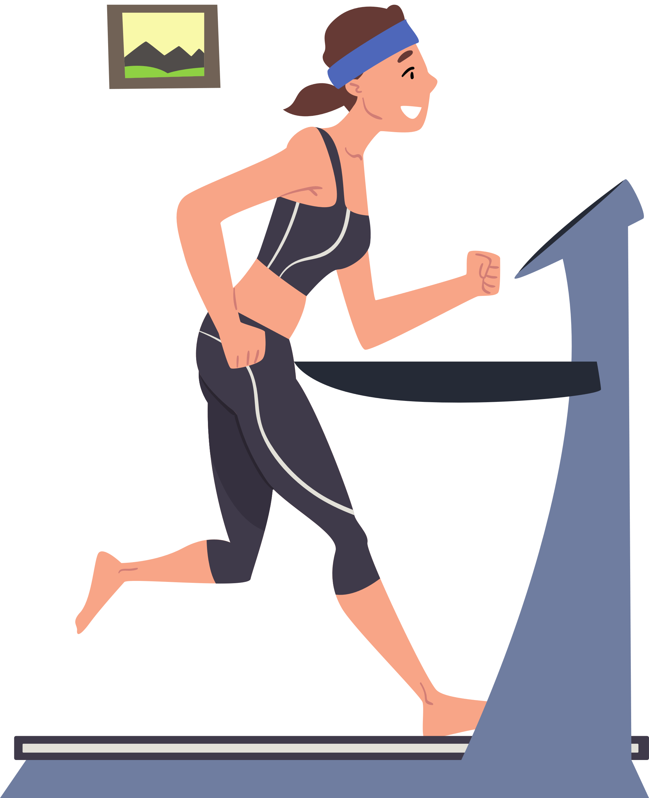
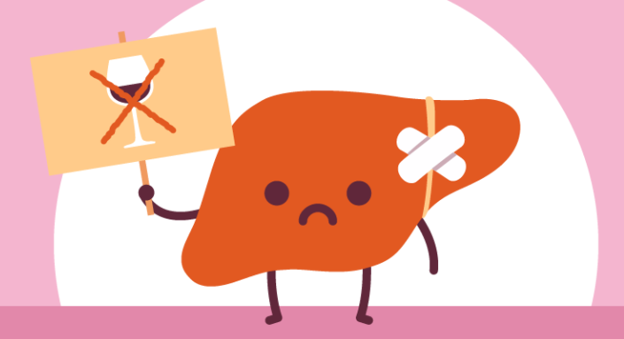
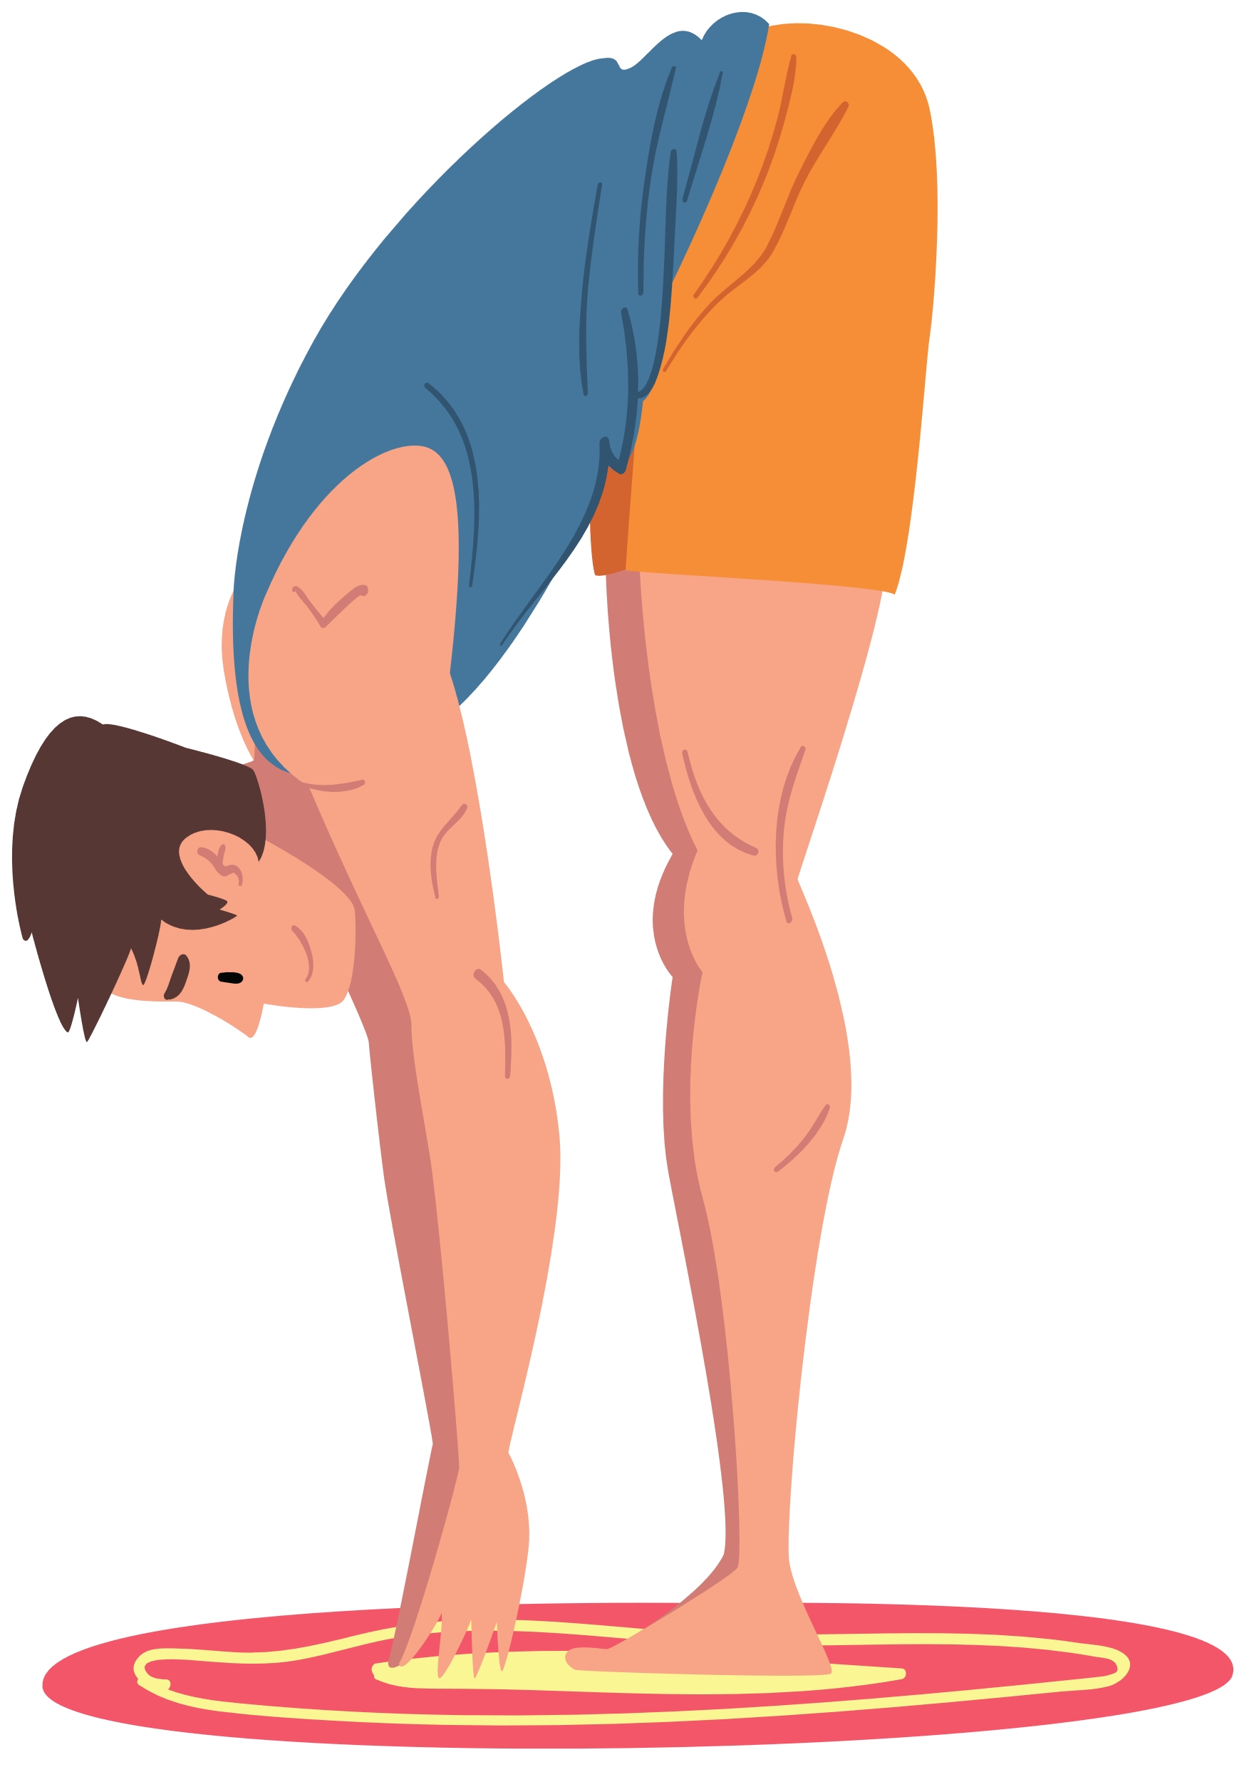


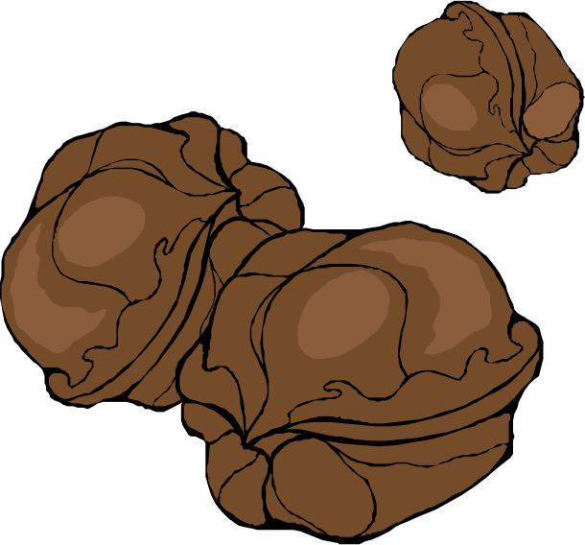

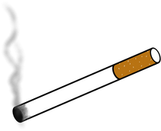

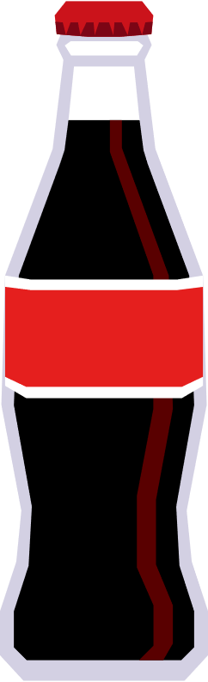
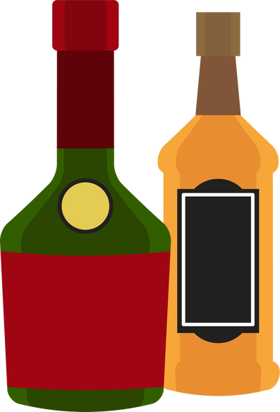


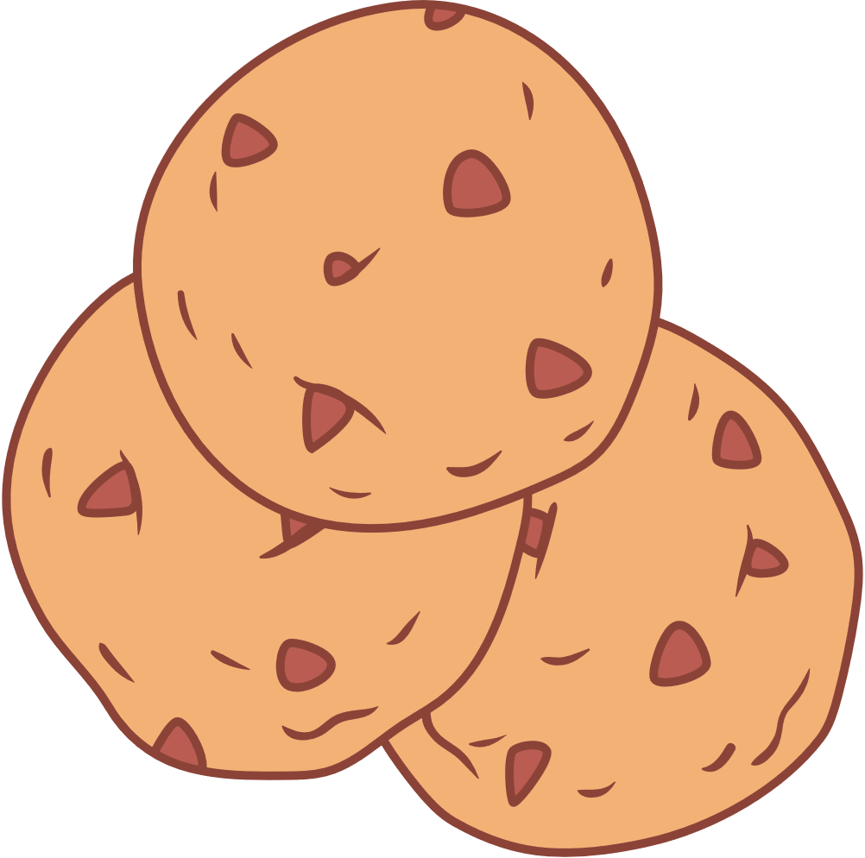




General Dietary/ Lifestyle Recommendations
Recommended
  Fresh fruits and vegetables
  nuts, seeds, legumes
  whole grains, rich in fiber
  Lean protein sources, fish
  Not recommended
  ALCOHOL
  Minimize
  Ultra-processed foods
  Sugary foods and beverages
  Saturated fats
Recommended Activity
  mental well being management
  aerobic exercise: cardio, walking, running, swimming etc.
  resistance exercise
  reduce sedentary behavior - don't sit too much
Francque et al. JHEP 2021
Notes:
Weight loss can be achieved by any dietary pattern and physical activity patterns that works best for you and this is an overview of what the recommendations are with regards to diet and lifestyle patterns. The key is to maintain these habits in the long term.
One of the most most studied diets is the Mediterranean diet pattern. It contains fresh vegetables, fruits whole grains, olive oil, and lean sources of protein.
With regards to physical activity: It probably doesn’t matter what specific type is done, and any increase in activity from your baseline activity is great. The key is to avoid sedentary behavior. We will delve more into the topic of diet, physical activity in sessions 4 and 5
The square to the right contains foods and drinks that are not recommended and should be minimized. These are highly processed foods or foods and drinks with added sugars

Slide 17


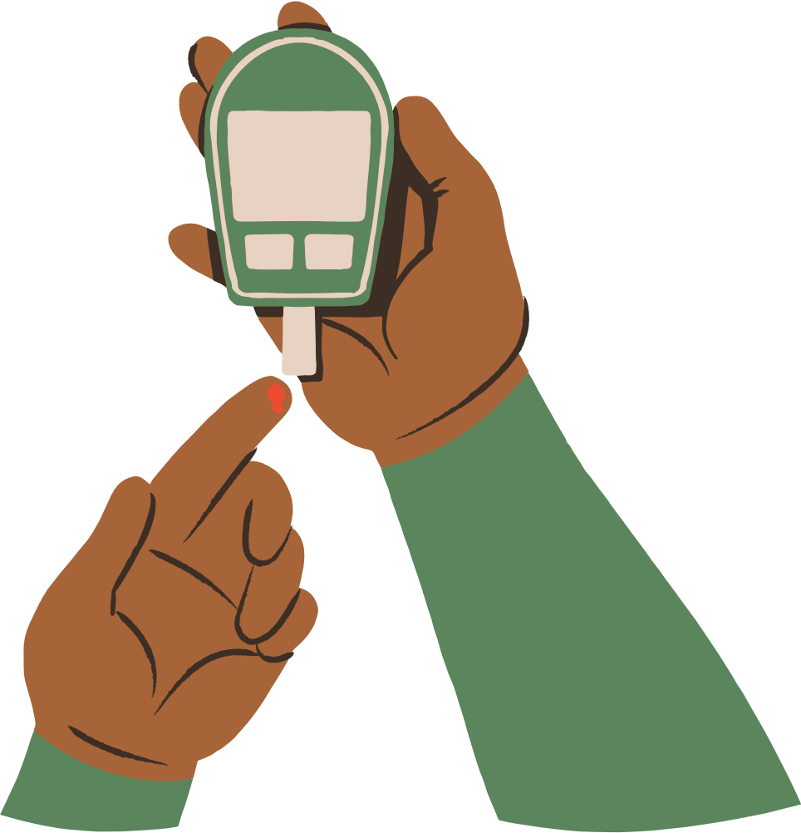

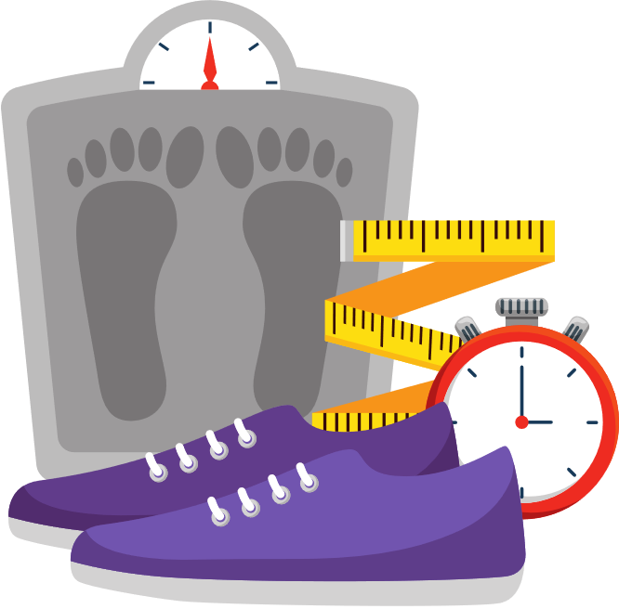






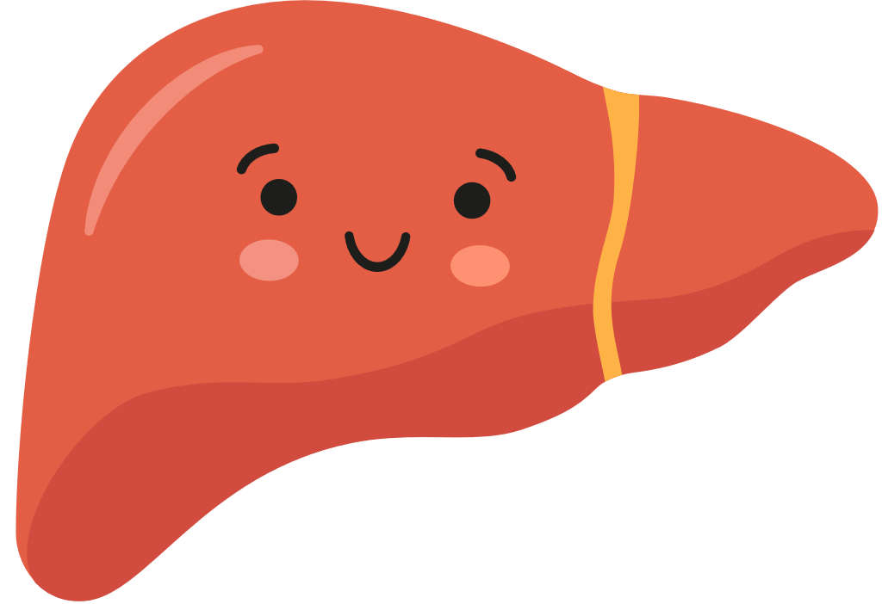

Lasting weight loss improves Metabolic Syndrome
If you are obese or overweight: Losing weight, especially stomach fat
Diabetes
Metabolic
Syndrome
Imbalance of good and bad cholesterol
High triglycerides
Improving insulin resistance
High blood pressure
Rinella et al. Hepatology 2023;
Arnett et al. J Am Coll Cardiol., 2019

Slide 18

Improving Metabolic Syndrome Decreases Cardiovascular Disease (CVD) Risk
Heart attack
stroke
Cirrhosis due to metabolic syndrome
Early CVD problems (disease of heart and blood vessels)
Rinella et al. Hepatology, 2023
Notes:
People with cirrhosis due to Metabolic syndrome are at a significantly higher risk of developing early heart problems that can increase the risk for a future cardiovascular event like heart attack or stroke.
The more components of metabolic syndrome and problems with the heart that someone has, the greater the risk for cardiovascular event like heart attack or stroke.
Because of this, we strongly recommend early recognition, prevention and treatment of the different components of metabolic syndrome
18

Slide 19
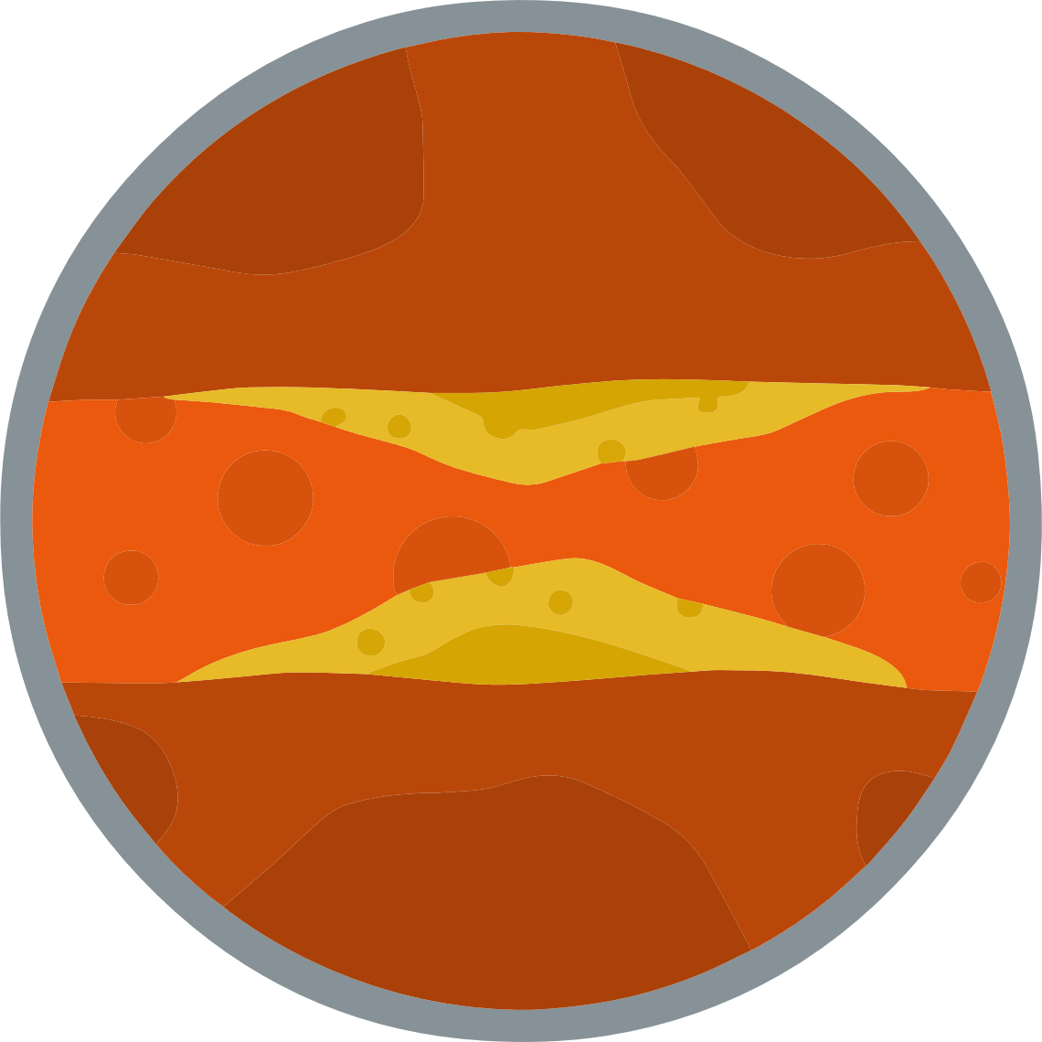
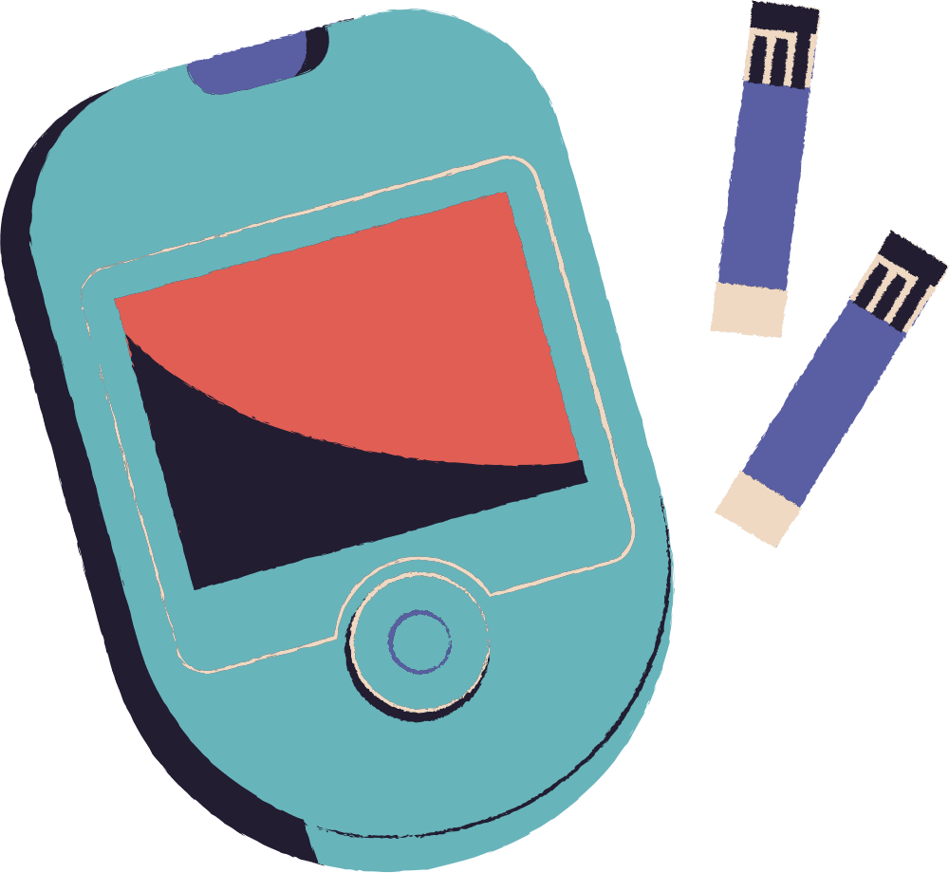
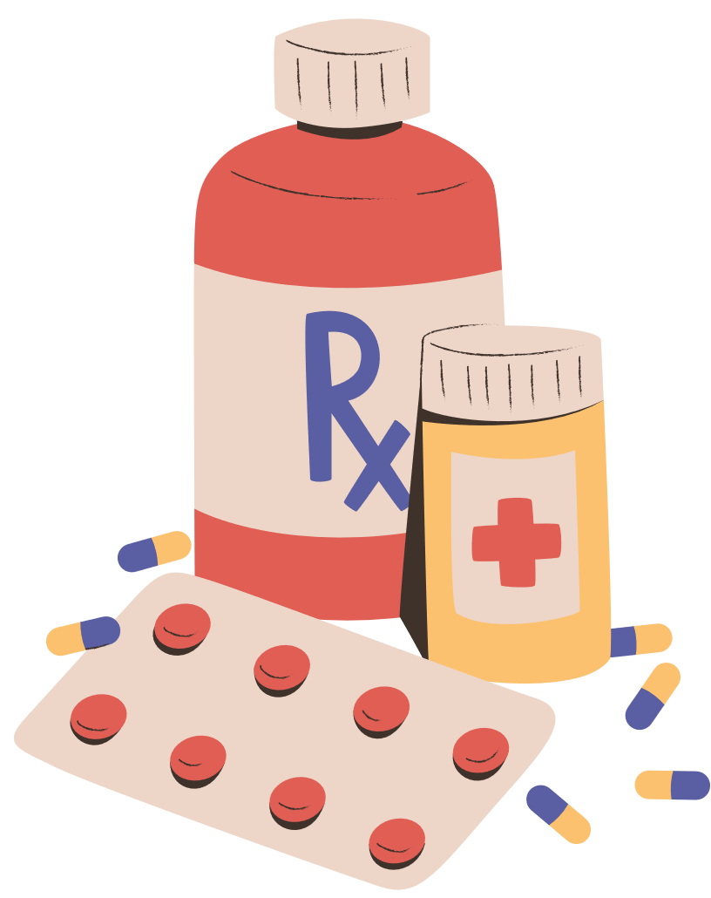
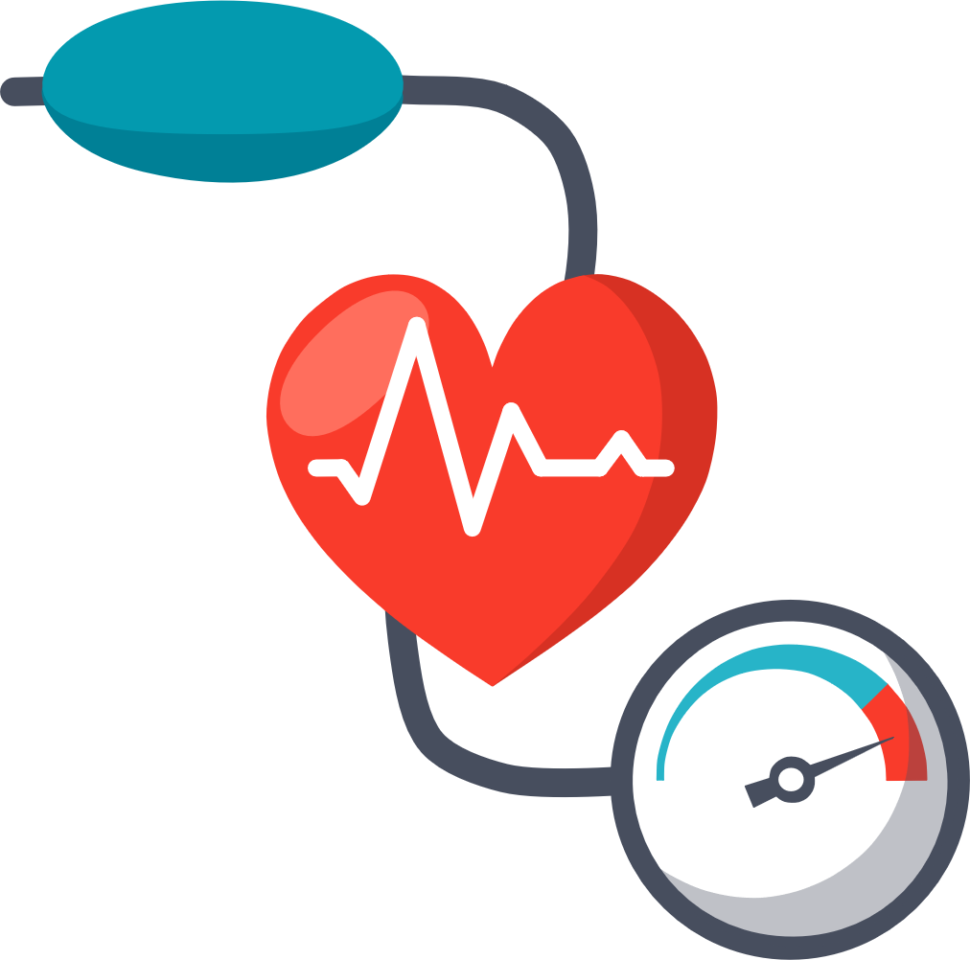
Are treatments for metabolic syndrome safe for the liver?
Abnormal cholesterol/triglycerides:
  Statins are safe for use in liver disease and rarely associated with liver toxicity
  Statins improve cardiovascular outcomes, decreased all-cause mortality, and liver cancer
Diabetes
  Metformin can promote weight loss, may improve liver enzymes, possible anti-cancer effects
  GLP-1 containing regimens (semaglutide/tirzepatide) or SGLT-2i promote weight loss, protect kidneys and improve CV outcomes.
Obesity
GLP1-RA (semaglutide or tirzepatide) may improve MASLD through weight loss
Hypertension
  Aggressive management reduces risk for CVD
  Carvedilol is anti-hypertensive choice for people with cirrhosis
Rinella et al. Hepatology, 2023, Arnett et al. J Am Coll Cardiol., 2019
Notes:
Medications to treat metabolic syndrome can reduce CVD risk are safe and even have benefits to the liver!
Statins are medications that are used to control cholesterol and are safe for use in liver disease. Statins improve cardiovascular outcomes, decrease mortality and some studies have shown lower liver cancer risk in patients who have been on statins.
For DM metformin is used and can promote weight loss, improved liver ezymes and has possible anti-cancer effects
There are newer diabetes agents that have been studied, which can protect kidneys and improve cardiovascular disease. These medications also can promote weight loss and may improve NAFLD
Managing HTN is important to reduce stress on the heart, and carvedilol may be a good choice as it can also help with portal HTN.
19

Slide 20
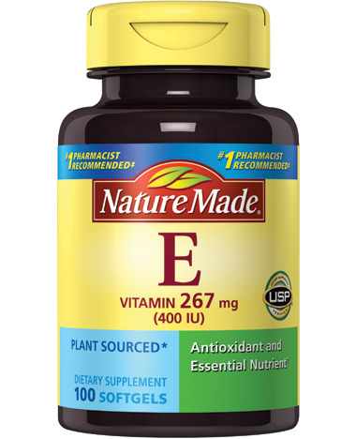
Medications and Clinical Research Studies?
  Vitamin E is prescribed for MASLD
    Anti-oxidant that helps protect liver cells
  Medications for steatohepatitis and to reverse liver fibrosis are currently being studied in people with cirrhosis
  UCSF has research studies
    If you are interested in being part of a research study, you can discuss with your hepatology provider
Sanyal A et al. NEJM 2010
Notes:
vitamin E, both of which were found to improve steatohepatitis in clinical trials. Vitamin E is only given for people with NASH or likely NASH.
20

Slide 21
Research Studies at UCSF for people with cirrhosis
Name of study | Diagnosis | Medication | Compensation? | Principal investigator
Madrigal clinical trial Effect of resmetirom in patients with MASH cirrhosis | MASH cirrhosis | Resmetirom | Closed enrollment | Dr. Hameed
GOLDMINE study | MASLD/MASH Cirrhosis | N/A | $50 a visit + $50 for each MRE scan | Dr. Hameed
Liver Cirrhosis Network (LCN) | Cirrhosis due to any etiology | N/A | no | Dr. Hameed
Akero clinical trial Effect of efruxifermin in patients with MASH cirrhosis | MASH with stage 2,3 and compensated cirrhosis | efruxifermin | no | Dr. Hameed
Notes:
Needs update?.

Slide 22
Collaborative care is key--with you at the center
Primary care provider
Manages metabolic factors
Lifestyle counseling
Hepatology provider
Cirrhosis management
Lifestyle counseling
YOU
Adapted from Brandman, CLD, 2019.
Notes:
The PCP and the hepatologist rely on each other to provide collaborative care, and you play the most important role with lifestyle!
21

Slide 23
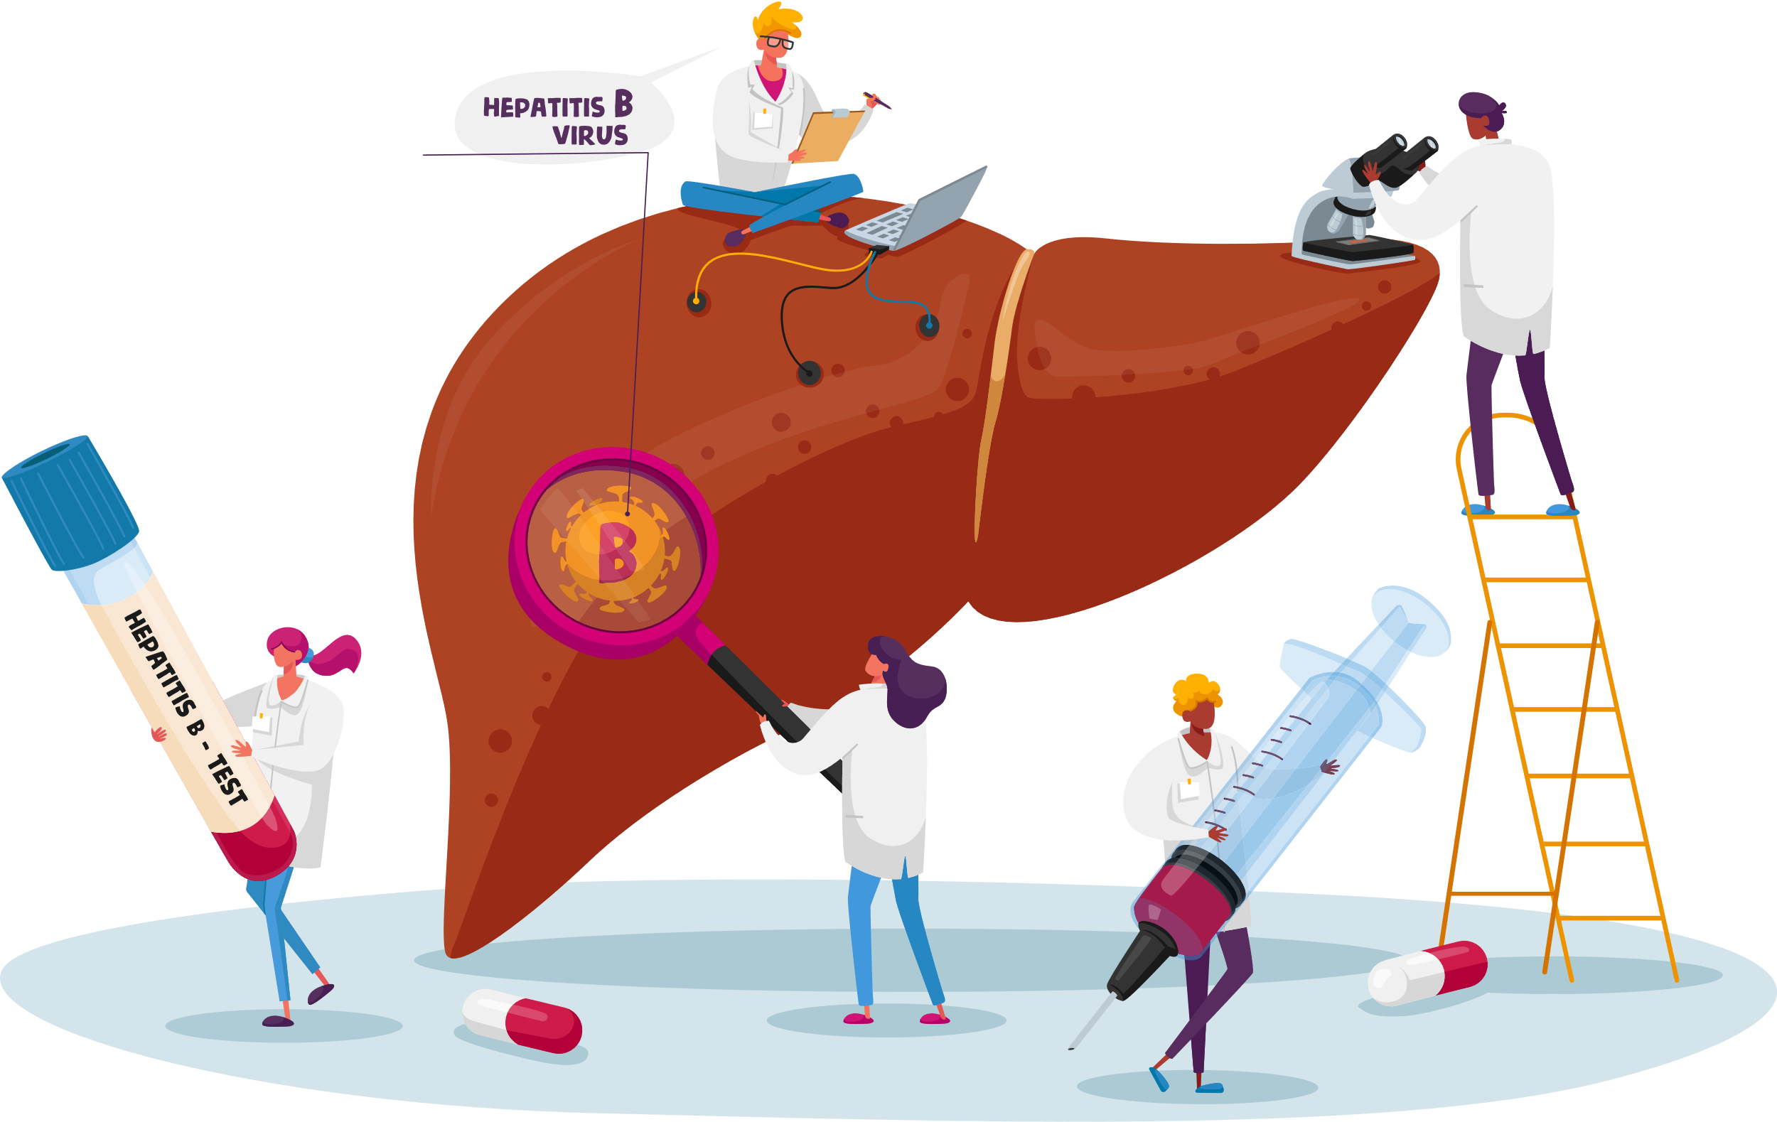
Key Points of BRIDGE Sessions 1-2
  The clinical course of cirrhosis is highly variable, often based on type of liver disease and genetic factors
  Cirrhosis is a risk factor for liver cancer, and screening is recommended indefinitely
  Follow up with hepatology provider regularly
  Follow up with other providers to manage metabolic syndrome factors, if present
Notes:
22

Slide 24

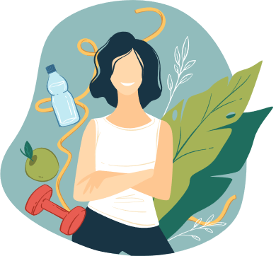


Key Points of BRIDGE Sessions 1-2
  Cardiovascular disease is the #1 cause of death in people with cirrhosis due to MASLD and care is collaborative with your primary care provider
  There’s a lot that you can do to improve liver and overall health outcomes
  No amount of alcohol is safe in cirrhosis
  Maintain healthy body weight/eating habits and regular physical activity
  You are an active participant in your liver management!

Slide 25
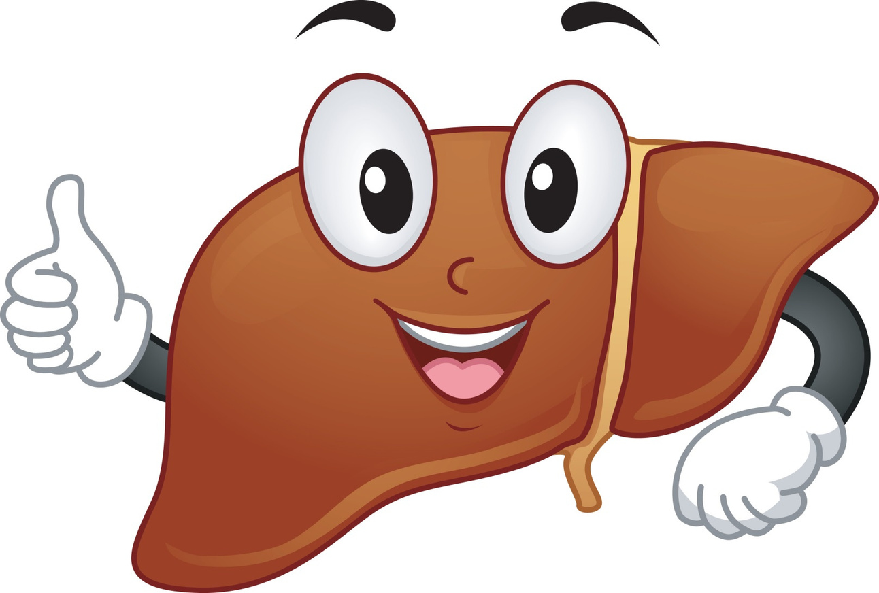
Questions?

Slide 26

Clarifying the values that drive our positive health habit goals
PAUSE.
NOTICE: My values*
  “What matters most to me?”
  “What gives my life meaning?”
  CHOOSE:
  What health habits do I want to work on?
    Dietary habits?
    Physical activity?
    Sleep habits?
    Manage stress? (ie thinking patterns, self-compassion/asking for support from others)
  On a scale of 0-10, how important is it for me to start working on this?
  Use the BRIDGE Goal Tracker tool to help you break your goals down into smaller actionable steps.
* Examples of values:
  Increase energy/vitality
  Feel serene/at peace
  Live longer or better
  Travel/adventure
  See kids grow
  Be role model for others
Notes:
PAUSE and notice what are the personal values that matter most to you: What gives my life meaning? Some examples may be increasing energy or vitality, feeling more at peace, living longer, seeing kids grow...
Values are not goals, but they direct your goals
If you’re ready you can CHOOSE 1 or 2 health habits that you'd like to focus on for your own self-care. Also rate how important it is for you to work on it.
Some of you may be in the beginning phase of deciding what area you'd like to work on, while others are ready to break down those areas into smaller actions to move you in the direction that you want to go.
The goal tracker is tool that can help us break the bigger goals down into actionable steps.
I'll be meeting with each of you 1:1 to discuss this, and if you feel comfortable you can share your values and goals with the group as I'm doing the breakout sessions.
26

Slide 27
BRIDGE Goal Tracker
Habit change goal Importance (scale of 0-10) | My Goal(s)* | What am I doing now | Possible Obstacles | Ways to overcome obstacles | My Challenges and Successes
Dietary habits ___ (0-10) | What: _________ Where:_________ When and how often: __________ How long or how much: _________ When will you start: __________
Physical activity ___ (0-10) | What: _________ Where:_________ When and how often: __________ How long or how much: _________ When will you start: __________
Sleep Habits ___ (0-10) | What: _________ Where:_________ When and how often: __________ How long or how much: _________ When will you start: __________
Thinking patterns ___ (0-10) | What: _________ Where:_________ When and how often: __________ How long or how much: _________ When will you start: __________
Social Support ___ (0-10) | What: _________ Where:_________ When and how often: __________ How long or how much: _________ When will you start: __________
Notes:
This is the Goal tracker that you received prior to this session, and it's a tool that you can use to break down your health habit goals, to help with self monitoring and with planning for obstacles.
Built into the goal tracker is asking yourself how important the goal is on a scale of 0-10 (if you assign 5 or below, you may need to break the specific goal down to easier steps or choose another area)
The next column has you answer more specific questions about a small step you'd like to take, (specifically what you will do, when, where, how often, ect.)
It also has a column for you're doing now, what are the obstacles and how to overcome them, then to self-evaluate the challenges and successes.
SMART stands for:
Specific: specify the actions you will take, when and where you will do so, and who or what is involved. Example of a vague or non-specific goal: “I will spend more time with my kids.” A specific goal: “I will take the kids to the park on Saturday to play baseball.” A non-specific goal: “I will be more loving towards my wife.” A specific goal: “I will ring my wife at lunchtime and tell her I love her.”
Measurable or Meaningful: The goal should be personally meaningful to you. If it is genuinely guided by your values, as opposed to following a rigid rule, or trying to please others, or trying to avoid some pain, then it will be meaningful. If it lacks a sense of meaning or purpose, check in and see if it is really guided by your values.
Acheivable/adaptive: Does the goal help you to take your life forwards in a direction that, as far as you can predict, is likely to improve the quality of that life?
Realistic: The goal should be realistically achievable. Take into account your health, competing demands on your time, financial status, and whether you have the skills to achieve it.
Time-bound: to increase the specificity of your goal, set a day, date and time for it. If this is not possible, set as accurate a time limit as you can
33

Slide 28
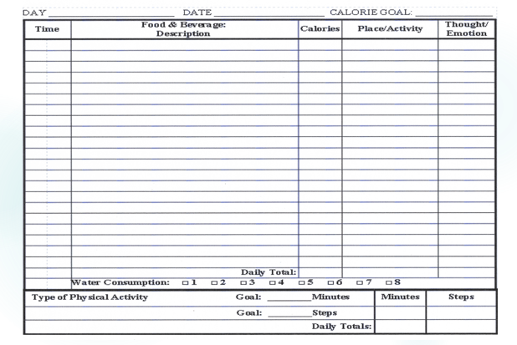
Food diary
Notes:
We are introducing the food diary today for you to think about tracking your daily food intake. This diary also contains columns on where and how you are eating, promoting mindful eating.
Keeping a food diary is associated with greater success with weight loss or maintenance of weight loss.
Some people also use Smart phone apps and some of you may already be doing this.
34

Slide 29
FOR NEXT TIME: BRIDGE session 3
  Come prepared with looking at and completing 1 row of the goal tracker
Notes:
28

