Slide 1
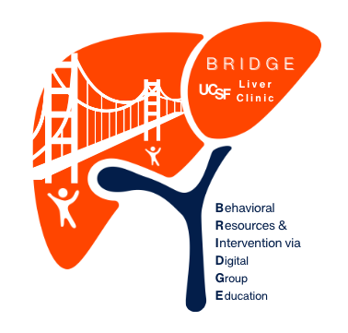
Welcome to BRIDGE!
Post-Transplant MASLD*
(formerly NAFLD)
*Metabolic dysfunction-Associated Steatotic Liver Disease

Slide 2

Introductions
  Name
  Something personal: food that reminds you of home, place/activity/hobby that brings you joy
  Skill you have you think will be an asset to the group
  What type of learner/communicator are you?
Notes:
Give up to 2-3 minutes per person. Recommend setting a timer to try to stay on track especially if running short on time
3

Slide 3

BRIDGE Structure
  Check-in: ~5 minutes
  Didactic session (lecture): ~15-20 minutes
  Discussion/Q&A: ~15 minutes
  Participation in group activity: ~20 minutes
  1:1 with leader for ~3 mins
Notes:
“Every session will start with a short didactic on topics relevant to fatty liver, followed by questions and discussion. The first few sessions have been designed to be more structured but as the series progresses, some sessions may become less structured to allow us to be more flexible according to your interests and needs.”
4

Slide 4
BRIDGE Goals
  Education about fatty liver and healthy lifestyle habits
  Provide tools/strategies to improve liver health
  Engage with peers
Health care
To foster self-awareness:
  What health behavior you’d like to change
  Your strengths to help promote change
  Barriers to change
Transplant care
BRIDGE
Notes:
BRIDGE is designed to complement, not replace your regular liver care. Rather than giving you the recommendations on what we think you should do to improve your liver, we’ll be shifting the focus onto you.
The goal of this group series is to:
Educate you about Fatty liver and the kinds of health behaviors that will promote liver health
Offer some evidence based tools and strategies to help you improve your fatty liver
Offer a forum for you to engage with peers to help process feelings about your liver and learn from each other too. Each of you may have different baseline knowledge,and are in different places with regards to lifestyle change goals. We think that these differences add to the richness of the group environment.
The power of BRIDGE is to foster self-awareness by helping one another explore what you might like to change, what strengths will help you change those things, and what may stand in the way of change.
5

Slide 5

BRIDGE curriculum
  Session 1: Intro to MASLD (formerly called NAFLD)
  Session 2: Improving outcomes in MASLD (NAFLD)
  Session 3: Motivation and making change
  Session 4: Eating habits for a healthy liver
  Session 5: Physical activity and fatty liver
  Session 6: Stress management

Slide 6

Zoom best practices
  Please mute your microphones
  Keep your camera on
  Chat box
    Use this to ask questions you think of during the lecture
    Use to include a thought or question during discussion if you’re worried you will forget later
Notes:
Questions will be held and addressed during the discussion/Q&A section
7

Slide 7

Confidentiality
  Your medical information may be discussed
  What happens in BRIDGE stays in BRIDGE
  Take care to prevent non-BRIDGE participants from overhearing the session unless they have signed the group confidentiality form
Notes:
Thank you all for signing the group telehealth confidentiality statement. We would like to reiterate the items in that form. . .
These are the 3 main points, I left out last 2 items since they’re more legal-ese
8

Slide 8





BRIDGE “ground rules”
Encourage attendance at all 6 sessions-- no penalty for missed sessions
Try your best to be on time
For Q&A: Please focus questions on behavioral aspects of liver health; personal medical questions should be directed to your Hepatology provider
During group discussion: Please provide support, not advice (unless asked): Discuss your own issues, experiences, and emotions rather than giving advice to other group members
Participation by all members is encouraged to the extent you are comfortable
Notes:
Try your best to be on time
We would love to have 100% attendance for each of the 6 sessions, but we understand this may not be possible. Please do let us know if you will not be able to attend. We do want to learn about barriers to sticking to a program such as this.
Participation is encouraged to the extent you are comfortable. No question is silly or stupid. If you are thinking of a question, chances are someone else is as well, so we do hope you will feel comfortable to speak up or write something in the chat.
I as your group facilitator may modulate participant involvement (getting things back on track) make sure we are able to hear unique contributions of all.
The spirt of this program is SUPPORTIVE. I encourage you to talk about your own issues and how they connect with others. You may hear others share their experience; remember that what works for one may not work for another.
Please don’t give advice unless it is asked for. No one here, including me, should try to make any of you change your health behavior; rather, we can best support one another by respecting the decisions of each individual
9

Slide 9



Introduction to MASLD
(formerly known as NAFLD)
Notice how you feel during the didactic presentation; in your body, thoughts, emotions.
Notes:
So we will dive into the didactic. During the presentation I’d like you to notice how you feel and what thoughts come up for you. This will be part of the patient activity after the presentation
10

Slide 10
Thoughts, beliefs, memories
What thoughts pop up in your mind?
Emotions and feelings
How does it make you feel?
Physical reactions
Notes:
Please get a piece of paper and draw three circles like on this slide. Thoughts of the past, present of future can come up and more personal questions about your liver may pop up for you as we go through this first session’s didactics.
In one circle write down emotions or feelings that come up for you, in another circle write in thoughts and beliefs that pop in your mind, and in another circle write down any physical sensations in your body. I’ve asked you to draw the circles like this because sometimes things can overlap.
11

Slide 11
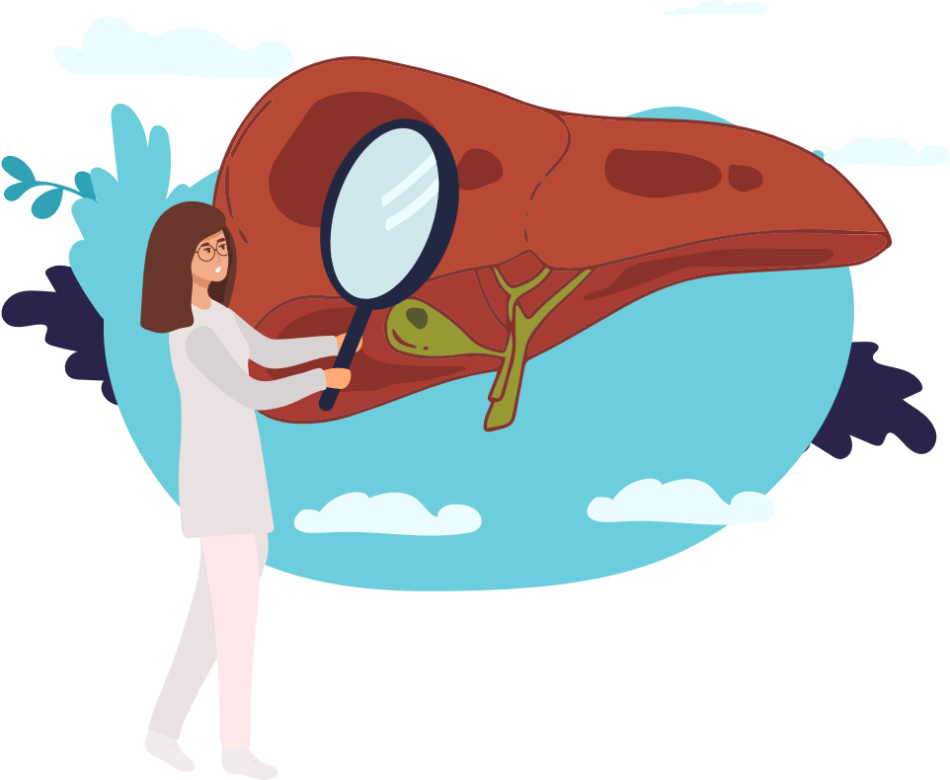
What do you know about your liver?
  What does the liver do?
  What is steatosis (fatty liver) and what are the causes of this?
Notes:
Remove this slide?
12

Slide 12
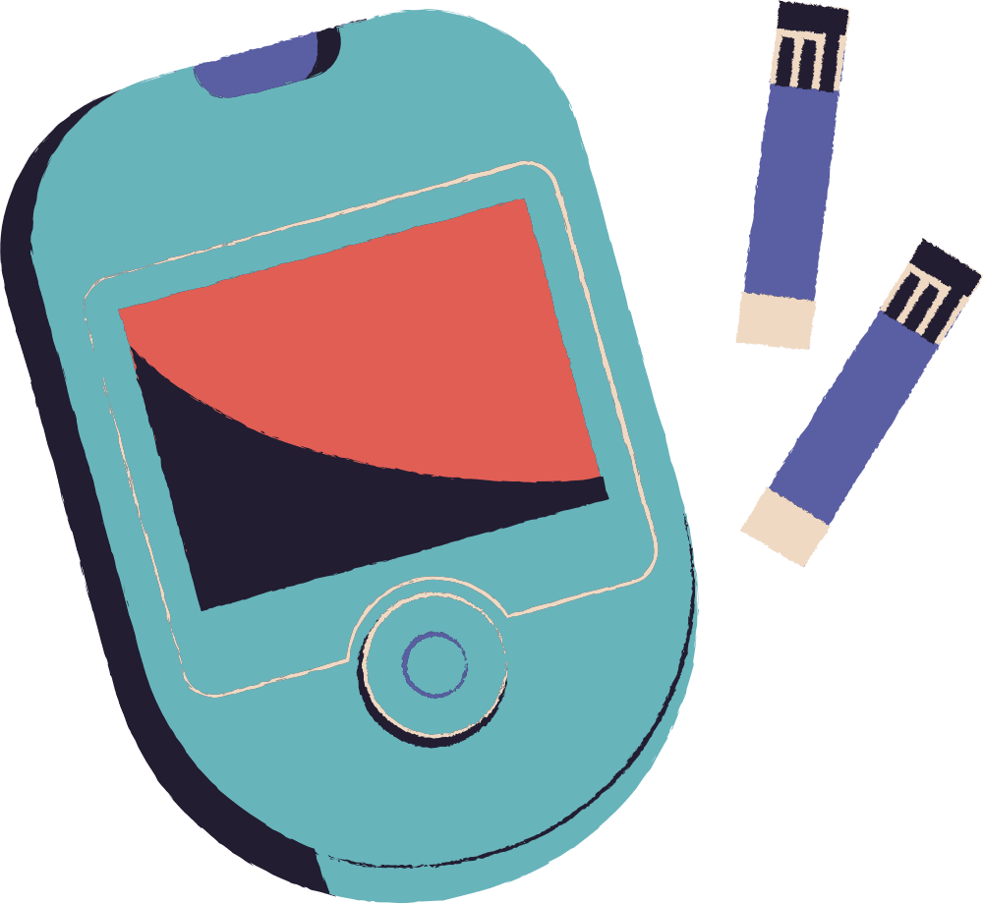
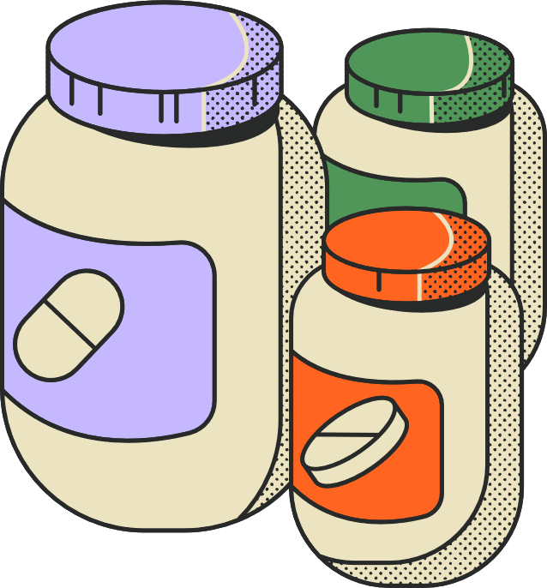
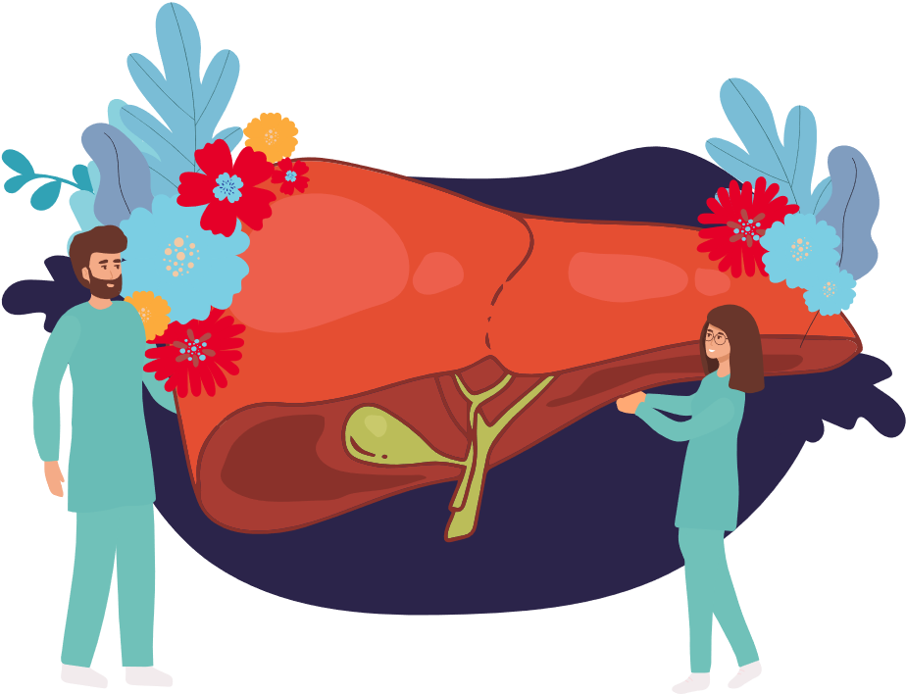


What does the liver do?
Regulates blood sugar and cholesterol levels and converts extra sugar into fat stores
Makes proteins for bodily functions
Metabolizes medications
Helps with digestion and fights infection by filtering out harmful organisms
Notes:
The liver has SO MANY functions to keep the body healthy. We won’t be going over all of these. ​
I will highlight the liver's role in handling sugars and lipids (fat molecules) from the food that we eat. When there is excess sugar and we don’t use it for energy, the liver will then store sugar and convert the excess blood sugar into fat (triglycerides).
Under normal conditions the triglycerides are stored in adipose tissue, but when there is excess the liver will store the triglycerides.
13

Slide 13
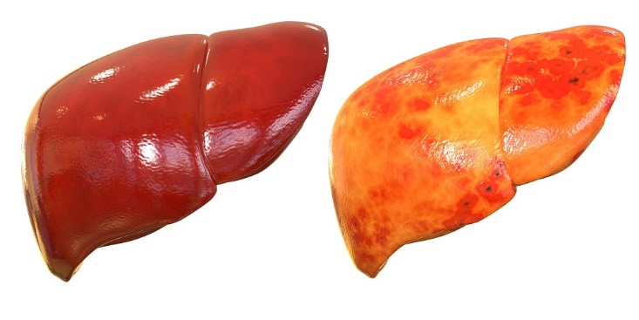
What is MASLD (aka NAFLD)?
Metabolic dysfunction-Associated Steatotic Liver Disease (MASLD, previously NAFLD) occurs when there is steatosis (fat accumulation) in the liver due to metabolic dysfunction, without other causes of steatosis identified
**Name changed in June 2023***
NAFLD MASLD
NASH MASH
https://www.aasld.org/new-nafld-nomenclature June 2023
Notes:
Metabolic dysfunction associated steatotic liver disease occurs what there is fat accumulation in the liver in the absence of other causes of fatty liver identified- such as Alcohol and some medications can also cause fatty liver but we won’t be covering this today​
How do you feel about the name change?

Slide 14
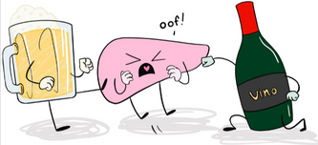
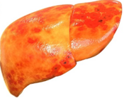
Alcohol also contributes to steatosis
Metabolic-dysfunction Associated Steatotic Liver Disease (MASLD)
Alcohol-associated Liver Disease
(ALD)
Steatotic liver disease Steatohepatitis (+ liver cell injury)
influenced by genetic and lifestyle factors
https://www.aasld.org/practice-guidelines June 2023
Notes:
Given advances in medicine for the treatment of viral hepatitis, steatotic (or Fatty) liver disease is becoming the most common etiology of cirrhosis and indication for liver transplant.
The 2 of most common reasons for liver steatosis are alcohol related liver disease and Metabolic dysfunction associated steatotic liver disease or MASLD. It can also be a combination of the two
Steatosis, or fat accumulates in the liver and in some people this can lead to steatohepatitis which is steatosis with inflammation and liver cell injury, and this is influenced by genetic and lifestyle factors

Slide 15
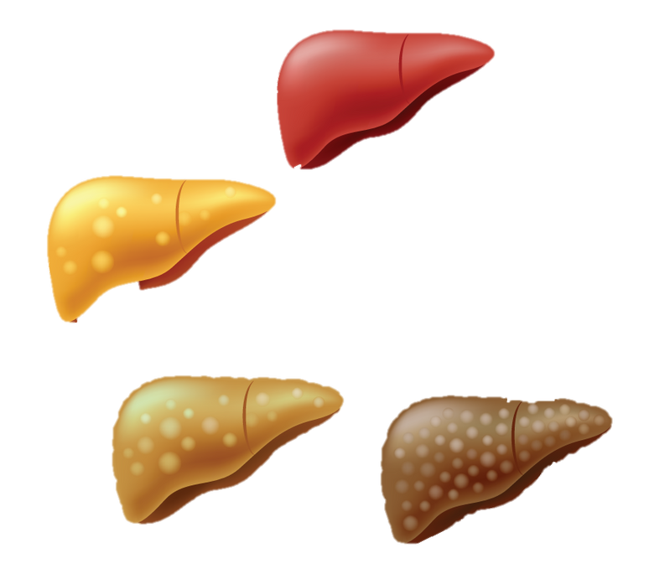


MASLD is a dynamic liver condition
Normal liver
Liver Steatosis
General population: > 30%
Post transplant recurrence: 90%
New onset after transplant: 40-50%
Metabolic- Associated Steatohepatitis
(aka MASH)
+/- liver fibrosis
(12-14% general population)
MASH Cirrhosis
40% of liver transplants
Younossi Z et al. Clin Mol Hepatol. 2025
Siddiqui MS et al Hepatology 2025
Notes:
In MASLD, a normal liver can develop steatosis or fat deposition, - in gen population it is very common (1/3 of population, and most will not have progressive liver disease.
There are different factors that can lead to steatosis after transplant- about 40-50% if LT recips develop new MASLD and about 90% of people will have recurrence of MASLD after transplant.
Some people can develop Metabolic Associated steatohepatitis, or MASH, which is type of MASLD that is most at risk for fibrosis and cirrhosis. Again, all of this is driven by genetic and lifestyle factors.
In the general population, 20-30% develop to cirrhosis. WE ARE STILL LEARNING ABOUT HOW NAFLD PROGRESSES in the liver transplant population. ​
Fatty liver is very dynamic condition, as people can transition in and out of NASH over the course of many years -- this is one of the challenges in understanding MASLD

Slide 16
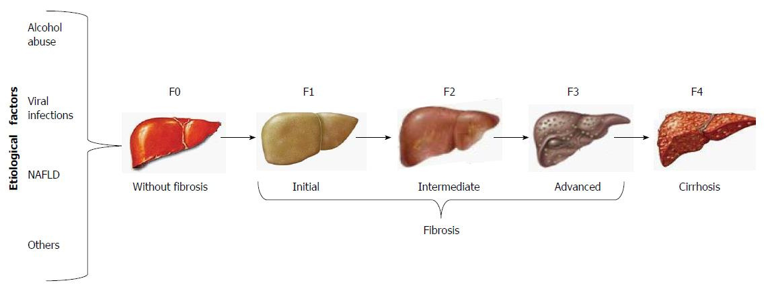
Liver fibrosis = liver scarring
No to mild liver scarring
Advanced liver scarring
Recurrent MASH after transplant may have faster rates of
liver fibrosis progression
Siddiqui MS et al Hepatology 2025
Notes:
Here is a visual representation of the different stages of fibrosis ranging from stage 0 or no fibrosis, which is the stage of the liver you got transplanted. It ranges to stage 4-- which is cirrhosis, and the stage of liver fibrosis when you got transplant. ​
Ongoing inflammation in the liver that can lead to progressive fibrosis over time.
Estimating liver fibrosis stage is important. When a liver is being damaged by an inflammatory agent like fat, alcohol or hepatitis for example it tries to repair itself by creating new tissue and as a result, develops scarring, which we call fibrosis. ​
Progression of fibrosis from post transplant NAFLD is highly variable, and not yet well defined. We know that some LT recipients can progress more rapidly than others. Generally patients with more metabolic syndrome risk factors are at higher risk for more rapid progression​
17

Slide 17


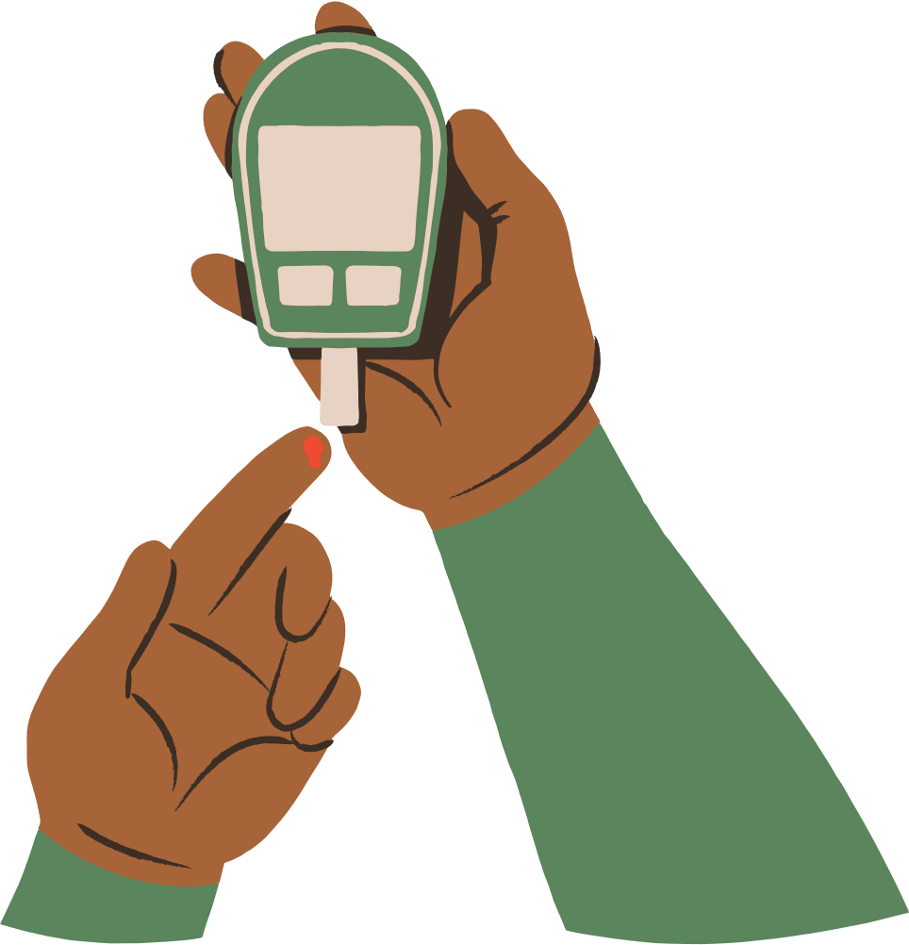









Post-transplant Metabolic Syndrome (PTMS) is common
Being obese, excessive abdominal fat
Loss of muscle mass
Diabetes
15-30%
Post-transplant Metabolic
Syndrome
40-60%
Imbalance of good and bad cholesterol
40-60%
High triglycerides
insulin resistance
50-70%
High blood pressure
60-70%
Rinella M. et al Hepatology 2023; Azhie et al, Liver Transplantation 2021
Notes:
As suggested by the new name of MASLD, it is closely linked to metabolic disorders that make up metabolic syndrome.
About 40-60% of liver transplant recipients are either obese or have excess body fat. This can lead to increased sugar levels and insulin resistance, when the cells of your liver and muscles don't respond to the hormone insulin, leading to high and conversion into fat molecules or triglyceride s& steatosis→contributes to the development of diabetes.
Overall 40-60% of transplant recipients have metabolic syndrome with 3 or more of the different conditions you see here.
Up to 30% have diabetes and up to 70% have abnormal cholesterol or high triglycerides and HTN

Slide 18
Transplant Factors leading to Weight Gain and PTMS
Transplant factors
Post-Transplant Metabolic syndrome
Anti-rejection drugs
Early post-transplant period:
  Increased appetite
  Change in energy metabolism after transplant
Intra-abdominal fat weight gain
Insulin resistance
DM
High blood pressure
dyslipidemia
Largest increase in weight often occurs during first year post-transplant
Azhie A, Liver Transplantation, 2021
Notes:
What are the factors that contribute to weight gain and PTMS? Medications used for immunosuppression -- like high doses of prednisone (steroids) can cause weight gain. Other meds like tacrolimus and sirolimus can cause elevated blood pressure and can increase risk for diabetes or high triglycerides
After transplant people become healthier and the metabolism changes in such a way that it is very easy to gain weight: appetite increases and change in energy metabolism after transplant can contribute to sometimes rapid weight gain in the first year after transplant.

Slide 19
Transplant Factors leading to Weight Gain and PTMS
Transplant factors
Post-Transplant
Metabolic
syndrome
Intra-abdominal fat weight gain
Insulin resistance
DM
High blood pressure
dyslipidemia
Sedentary Lifestyle
Dietary factors
  Processed foods
  High sugar intake
Pre-transplant metabolic syndrome
Older age
Hereditary/Genetic factors
Donor liver??
Azhie A, Liver Transplantation, 2021
Siddiqui MS et al. Hepatology 2025
Notes:
There are also factors that are not related to having a liver transplant which can contribute to post transplant metabolic syndrome.
I have circled the things here-- sedentary lifestyle and poor dietary habits-- which can worsen metabolic syndrome.
The things that cannot be modified are also important contributors to metS and are listed here too – pre-transplant metabolic syndrome, older age and genetics/hereditary factors.

Slide 20
Transplant Factors leading to Weight Gain and PTMS
Transplant factors
Post-Transplant Metabolic
syndrome
Intra-abdominal fat weight gain
Insulin resistance
DM
High blood pressure
dyslipidemia
Sedentary Lifestyle
Dietary factors
  Processed foods
  High sugar intake
Pre-transplant metabolic syndrome
Older age
Hereditary/Genetic factors
Donor liver??
Azhie A, Liver Transplantation, 2021
Notes:
If people make changes in these habits, they can improve and in some cases resolve metabolic syndrome. We will be focusing mostly on these aspects throughout the BRIDGE series to reduce this risk

Slide 21
How is MASLD diagnosed after LT?
Elevated liver enzymes may occur
  Missed anti-rejection meds? Alcohol intake? New med? Recent illness? Weight gain?
  Abdominal sonogram
Fibroscan or other non-invasive tool
Liver biopsy to check for rejection (maybe)
MASLD is a diagnosis of exclusion
Notes:
NAFLD is a diagnosis of exclusion and there is no laboratory marker for it. Every case is unique in people with liver transplants. Our protocol has been modified over the years as we have learned more about this condition.
Patients who had been transplanted for NASH receive an annual Fibroscan test, which most of you have had and I will describe more later.
Elevated liver enzymes may occur in post transplant NAFLD., but not always. If your transplant provider sees your liver tests trending up, they will ask a set of usual questions, like any missed doses of transplant meds, drinking any alcohol, any new medications/supplements, or if you have had a recent illness as sometimes this can cause the liver enzymes to increase. They will also ask if you have gained weight.
Usually you will be asked to do an abdominal sonogram to visualize the structure of the liver and fatty liver can be seen this way. Depending on the degree of liver test elevation a biopsy may be needed. After we have excluded other causes of liver disease, we diagnose NAFLD

Slide 22

Role of liver biopsy
  Best way to determine the cause of the elevated liver enzymes in transplant patients
  Rule out rejection
  Determine the presence of MASH and fibrosis
Notes:
For liver transplant recipients, often the best way to determine the cause of elevated liver enzymes is through a liver biopsy. The bx can reliably rule out rejection and determine whether or not steatohepatitis is present and assign a fibrosis stage.
We can only diagnose MASH by biopsy.
28

Slide 23
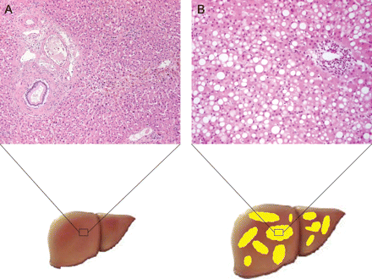
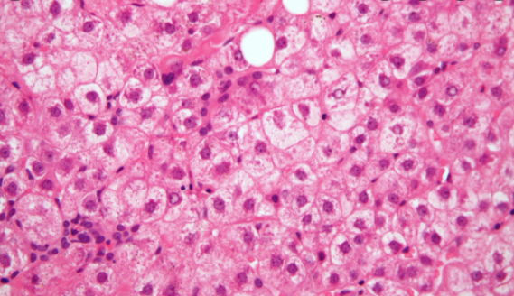
What does MASLD look like
NASH
Non-Alcoholic Steatohepatitis
Normal liver
Steatosis
(simple fatty liver)
Bhatia EHJ, 2021
Notes:
EXTRA SLIDE for patients' reference.
Here are biopsy slides comparing a normal liver tissue and a liver tissue with steatosis
On the left is a normal looking liver. To the right of that you can the big white dots represent fat globules or “steatosis” which fill up the whole inner part of the liver cell and push the other part of the cell to the cell border. <CLICK> Some livers over time develop “ballooning” or swelling of the liver cells as you can see here. The cells can develop a ropey tissue which indicate that liver cell damage is occuring and steatohepatitis or NASH is present. As the liver loses its ability to repair itself, fibrotic tissue or liver scar tissue develops.
As I said in the beginning of this didactic, we know that NASH activity in the liver cells is closely linked to liver fibrosis or the development of liver scar tissue

Slide 24
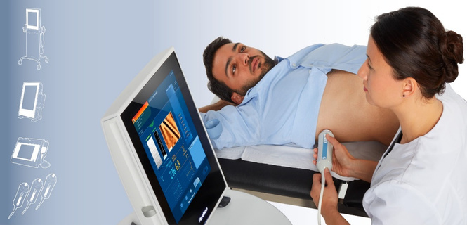
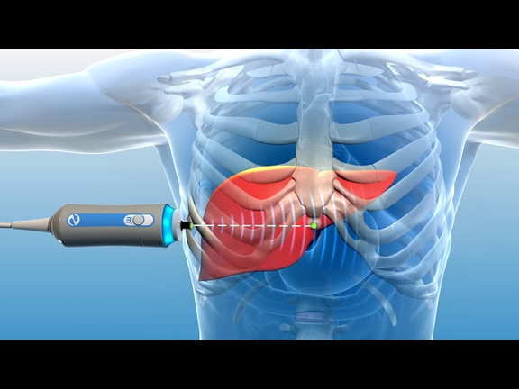
Transient Elastography: Fibroscan
  Liver stiffness measurement (LSM)
    Estimates liver scar (fibrosis) stage
  Controlled attenuation parameter (CAP)
    Estimates liver fat severity
Notes:
But often the first step is for us to get a Fibroscan, a non-invasive tool that most of you have had at one point. The Fibroscan has been studied a lot in non-transplant patients and is a good way to differentiate between advanced liver fibrosis or mild fibrosis –but in transplant patients it hasn’t been studied as much yet.
The Fibroscan works by sending a shear sound wave through the liver and measures how quickly it travels through it, giving us a liver stiffness score. When there is high liver fat or liver enzymes- the stiffness score can be falsely elevated, and overestimate the stage of fibrosis.​

Slide 25
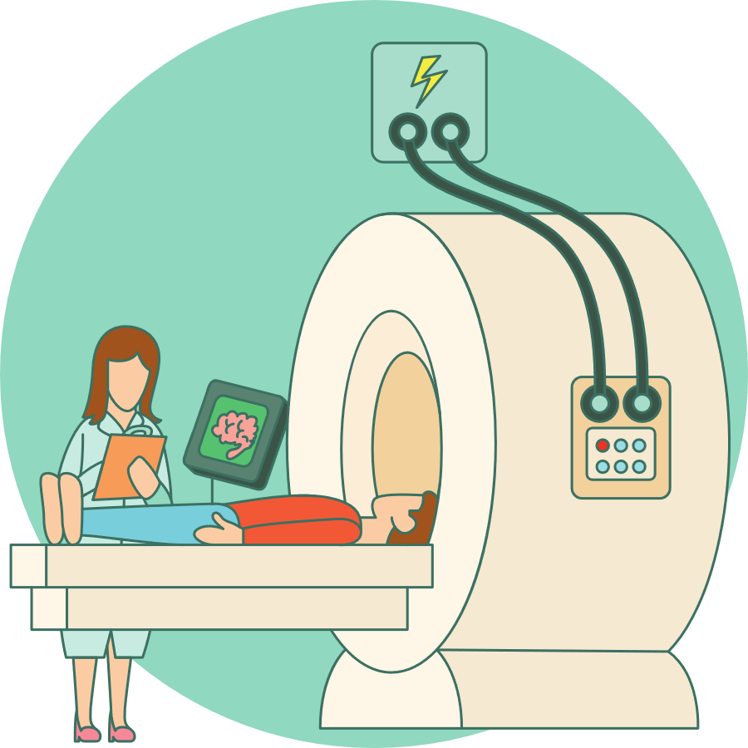
MRI or Ultrasound Elastography
  Non-invasive imaging tools estimate liver scar (fibrosis)
  Calculates liver fat content
Notes:
Sometimes when we’re not sure of the accuracy of the Fibroscan result, we will ask you to get an MRE to have another tool to estimate fibrosis stage and fat content. This test has not been validated in transplant patients either, but is a really good tool for patients with MASLD who haven’t had a liver transplant
27

Slide 26
NAFLD after LT is common
Advanced fibrosis is not common
 | Incidence after LT
NAFLD | 20-100%
NASH | 5-52%
Advanced fibrosis | 2-74%
Some may rapidly progress to NASH cirrhosis (~12%)
The number of metabolic factors may influence risk for rapid fibrosis progression
Spiritos Z &Abdelmalekb M. Transl Gastroenterol Hepatol 2021
Notes:
Although NAFLD is common after transplant and we are learning that advanced fibrosis is not common. This chart shows very wide ranges in the percentages of liver transplant patients with NAFLD, NASH and advanced fibrosis. When we see these wide variations in the percentages it usually means we are not exactly sure. You can see a very wide range of 2-74% with advanced fibrosis. Some studies have found that about 12% of LT patients rapidly progressing to NASH cirrhosis. This has been found to be closely associated with the number of metabolic factors someone has and with advanced age.
Other points:
- Several studies have reported that 80-100% of people who were transplanted due to NASH get NAFLD by 5 years after transplant
- Up to 50% in patients who were transplanted for other reasons can get de novo NAFLD by 5 years.

Slide 27
No difference in survival after transplant with MASLD
Narayanan P et al. Transplantation 2019
Galvin Z et al. Liver Transplantation 2019
Notes:
Good news about what we've learned so far about post-transplant NAFLD is that there is NO DIFFERENCE IN SURVIVAL after transplant when NAFLD is present.
If you look at the blue bar which represents LT recipients with steatosis, and compare it to the green bar which represents LT recipients without fatty liver, there are very similar rates of post-transplant survival.
Overall 1-5 year survivals afer OLT are 80-90% and 70-85% respectively
20 year survival 50%

Slide 28
MASLD affects diabetes, the kidneys and the heart
While diabetes can contribute to liver steatosis, having liver steatosis also increases risk of diabetes
Chronic kidney problems
  MASH is associated with 3-4 times higher risk of developing chronic kidney disease
Cardiovascular Disease (disease of heart or vessels of heart)
  CV disease is most common cause of death outside of liver graft failure or infections.
Maliakkal B Transl Gastroenterol Hepatol 2020; D’Avola et al. Liver Transplantation 2017; Houlihan. Liver Transplant 2011
Notes:
Having MASLD can affect other parts of your health. Because the liver is involved in the metabolism of glucose, it can increase risk of developing or worsening type 2 diabetes. Chronic kidney problems is also seen in patients with NAFLD, especially people with NASH.
Most importantly, transplant recipients with NAFLD experience more cardiovascular problems this is the most common cause of death in people with post transplant NAFLD.

Slide 29
Cardiovascular Disease poses highest health risk in MASLD
Chronic inflammation
Heart attack or
stroke
CV problems
(disease of heart and blood vessels)
PTMS and MASLD
Intra-abdominal fat
Sarif A. Am J Transplant 2010; Azhie A. Liver Transplantation, 2021
Notes:
This cartoon shows how Metabolic syndrome and MASLD can promote the development of cardiovascular problems--which can increase the risk for heart attack or stroke.
Studies have shown a strong connection between MASLD, metabolic syndrome and the heart. This is probably driven by chronic inflammation from fatty tissue in the abdomen, which contribute to early heart problems, increasing the risk for heart attack and stroke.
Because cardiovascular disease is the most common cause of illness and death after liver transplant it’s important to have early recognition, prevention and treatment of metabolic syndrome and we will focus on this more in our next session.

Slide 30
Summary
MASLD is common after transplant, especially in patients who had it before transplant
MASH associated higher risk of liver fibrosis progression
No difference in survival in patients with and without post-transplant MASLD
MASLD is associated with metabolic syndrome, higher risk for heart and kidney problems after transplant
Cardiovascular disease poses the highest long-term health risk in post liver transplant MASLD

Slide 31

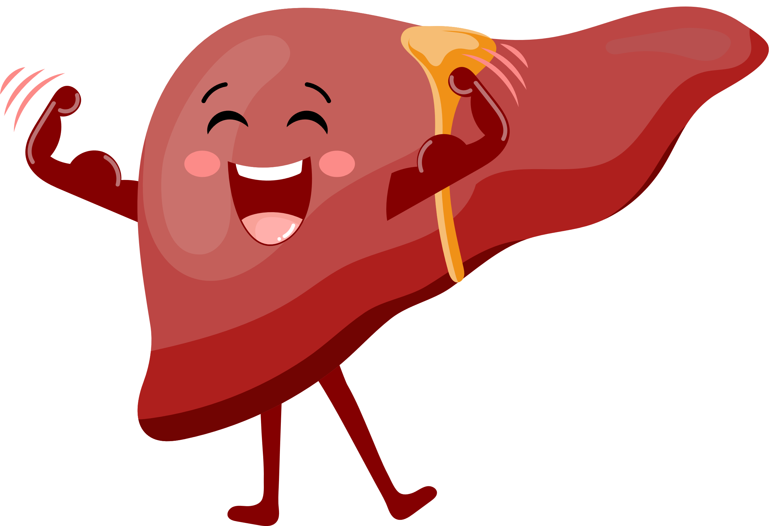
Key Take Aways
  The following BRIDGE sessions will provide information you can use to create an action plan that leads to improved liver health and overall well-being!

Slide 32

Group activity
  Group activity:
    Notice how you felt during the presentation: in your body, thoughts, emotions.
    Do the feelings or thoughts trigger you to do something?
  Brief one-on-one breakout session with me
    I will ask your weight and about your level of awareness of different behavioral changes that you can do to improve your liver.
Notes:
Today’s didactic on NAFLD may have brought up feelings and thoughts for you. How do you feel in your body, in your heart and in your mind right now? Are there emotions that you have, sensations in your body, thoughts that pop up? For example: one person may feel worried or distressed, notice that their heart is beating fast, and another may feel hopeful and relieved and notice that they are breathing better. Thoughts of the past, present of future can come up and more personalized questions about your liver may pop up for you.
34

Slide 33
Life Events or environment
Thoughts, memories
Physical symptoms
Mood
Health-related behaviors
Adapted from Greenburger & Padesky,
Mind Over Mood, 2016
Notes:
We’ve provided this tool as “homework” for you to use over the next 2 weeks, to help you to notice how our environment, thoughts, mood, health related behavior and physical symptoms are interconnected
Any positive change of any of these factors could result in a positive change in the others.
Our feelings are very often being driven by what we are thinking, imaging or remembering.
Strong feelings like fear, hopelessness, anxiety are triggered by emotionally charged hot thoughts

Slide 34
Catastrophic thinking about having
a liver condition
Thoughts
“My liver will fail”
Physical Reactions
Mood
Tense, sleepless
Fear, anxiety, hopelessness
Health related Behaviors
Isolation / Avoidance / Decreased self-care
Notes:
Let’s take the example of catastrophic thinking “I will die from liver cancer” is a hot thought.
Ask participants:
First of all is it 100% true? What part is true and what part is not true?
How do you think that it makes a person feel? XX
How do you think it impacts someone’s behaviors XX or physical reactions? XX
28

Slide 35
ALTERNATIVE way of thinking about having a liver condition
Thoughts
“I can take steps to improve my liver health”
Physical Reactions
Mood
More relaxed with improved sleep
Hopeful, peaceful
Health-related Behaviors
Engaging in self-care
Timely liver imaging studies
Notes:
So what would be an alternative way of thinking about liver cancer risk?
Ask the participants about alternative thought XX
How does this way of thinking change how someone would feel XX
How do you think it would affect a persons behavior XX
Or physical symptoms? XX
What I’d like you to focus on over the next week is notice how all of these things are connected. I’ve provided this model as a separate handout as homework over the next week.
If you feel it’s helpful, I’ve provided you another handout called the Thought-Mood-Behavior Record, where you can down how your thoughts & mood impact your health behaviors.
29

Slide 36
Thoughts and beliefs
What was going through your mind? Words, images or memories
Emotions, feelings,mood
What did you feel or what mood do you have?
How do your thoughts and feelings influence your health behaviors?
Physical reactions
Notes:
Thoughts of the past, present of future can come up, and I’d like to open up for discussion the things that came up for you. I’d also like you to think about how your thoughts and mood can influence your health behaviors
35

Slide 37
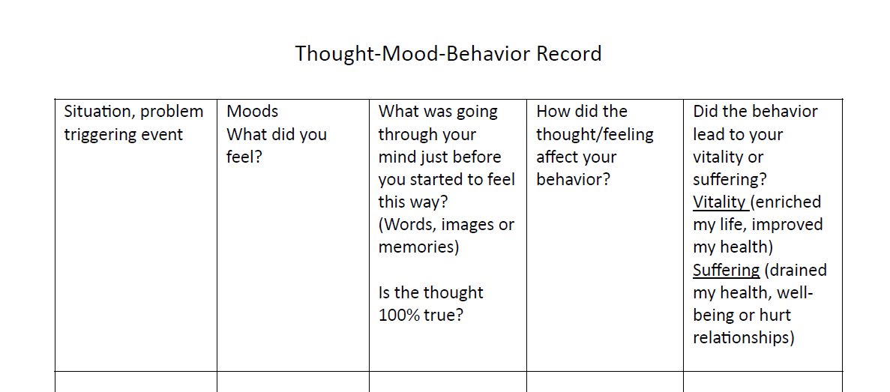
Optional tool to monitor how thoughts and mood impact behavior
Notes:
30

Slide 38
BRIDGE Session #2:
Improving outcomes in MASLD

